Slide 1
Course on Caeleste’s in house SAR ADC

Slide 2
History record
20161011 Bart started PPT, largely empty
20220922 SCIB team added chapter4 and list of future improvements
20220926 Bart edits, reordering chapters
20220926 Arne incorporate earlier course for Test team
20221005 Bart complete revision after ATON NCR07
20221006 SCIB team offchip mitigation of odd-even effect
20221007 Bart presented first part at CU
20221104 Bart presented remainder at CU
20230127 Bart created separate section on the non-binary SARADC
20230315 Ahmed preparation of review
20241014 Bart cleaned up and streamlined the section on SASC

Slide 3
purpose
This course is about Caeleste’s in-house SARADCs.
Primer and reference on the basic concepts
For the designer of on-chip SARADCs
For the test engineer evaluating these
Overview of building blocks and features
In dept discussion on issues
Paths to future improvements
Disclaimer
This is not a general course on ADCs
An onset of general course is in BP049, “general ADC design”

Slide 4
History of Caeleste SARADCs
Generation 1 was a 16-bit traditional SARADC designed for Campanion1
Generations 2-9 and 11 were 12-bit SARADCs with improvements as unary/binary/RDAC, postcorrection and double conversion. They had in-ADC regulation and oversampling. It used interleaving groups.
Up to SARADC generation 9, the architecture was essentially a binary code SARADC
As a consequence of NRC07 or ATON, radical improvements were proposed, under which a new approach to substitute the unary/binary CDAC by a pure capacitive non-binary CDAC.
Generation 10 is the non-binary SARADC. The reason to move to non-binary is self-correction of conversion errors and code gaps. Secondly it has a much more compact sequencer and logic, simpler and smaller CDAC, faster operation and lower power. It has however a calibration burden.
Then came Helena. Helena inherited much of the Generation 10 and before, however it is conceived for low EPC and high CSA. It is built around the “SASC” library. The SARADC is of the monotonic switching type. It abandons in-ADC regulation and replaces it by the “split capacitor” trick. It allows both binary and non-binary implementations. It abandons interleaving.

Slide 5
Table of contents
The course has three sections
Binary SARADCs (legacy)
concepts
SARADC major subcircuits
Binary SARADC issues
List of possible future improvements
Non-binary SARADCs (legacy)
Concepts
Major subcircuits
List of possible future improvements
The Helena (SASC) SARADCs
Helena philosophy and FOMs
The SASC library concept

Slide 6
outline
Binary SARADC
Non-binary SARADC
Helena

Slide 7
Student prior knowledge
Study relevant parts of CAMPANION1&2 deliverables
Look into Notebooks 0022, 0032, 0045, 0226, 0287, 0516, 0635, 0645, 0746, 0769
See also the paragraphs on ADC in BP031 Measurement procedures
Review all quantities measured and understand what they mean.

Slide 8
Goal of this course
Understand why we chose a certain SARADC concept
Why binary and why go to non-binary?
Why differential? Why pseudodifferential?
Why interleaving? And full parallel?
Understand the CDAC concept, how to construct a CDAC
Why unary, binary, RDAC,
Why non-binary and how to calibrate that?
Understand the comparator, clocked or not clocked, its auto-zeroing, its output signals.
What is double conversion, what is postcorrection and how to solve the odd/even effect
Why and how can we do oversampling
Understand the array aspects
Understand and contribute to future improvements
Improving speed / power
Increase resolution
Reduce large conversion errors, reduce noise, improve DNL/INL, improve PSR
Strive to a true standard cell, with simple parametrization.

Slide 9
1. Binary SARADC
Generation 2-9 and 11

Slide 10
Goal of this course
Understand why we historically chose the binary SARADC concept
Why differential? Why pseudodifferential?
Why interleaving? And full parallel?
Understand the CDAC concept, how to construct a CDAC
Why unary, binary, RDAC,
Understand the comparator, clocked or not clocked, its auto-zeroing, its output signals.
What is double conversion, what is postcorrection and how to solve the odd/even effect
Why and how can we do oversampling
Understand the array aspects
Understand and contribute to future improvements
Improving speed / power
Increase resolution
Reduce large conversion errors, reduce noise, improve DNL/INL, improve PSR

Slide 11
SARADC Concepts

Slide 12
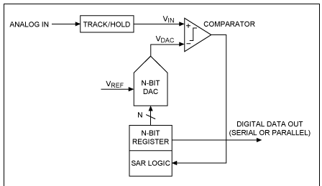
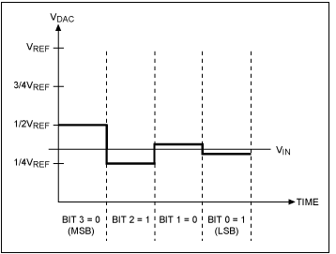
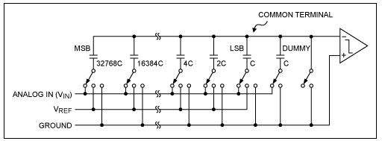
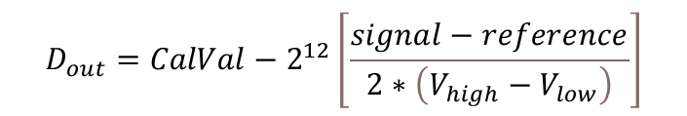
SAR ADC principle of operation
https://www.maximintegrated.com/en/design/technical-documents/tutorials/1/1080.html
Textbook example of single-ended Successive Approximation Register (SAR) ADC with a Capacitive DAC (CDAC)
$$D_{out}=CalVal−2^{12}\left[\frac{signal−reference}{2∗\left(V_{high}−V_{low}\right)}\right]$$

Slide 13
Why our SARADC concept
The Successive Approximation Register ADC concept
Is widely used (“thus it must be good!” – this is not a good reason)
It is often reported by others with the best FOMs – this is a good reason
Especially conversion rate per unit area, for resolutions in the order of 12 bit
Is easily portably as it only needs plain CMOS and symmetric (MIM, POD) capacitors.
Accepts the “native” pseudodifferential signal of imagers. And then performs CDS.
Interleaving
Fits nicely on top of interleaving X-scanning buses as also used in image sensors.
Elegant solution to output multiple sub-ADCs on a single serial stream.
Equalizes the peak current on the CDAC reference voltages

Slide 14
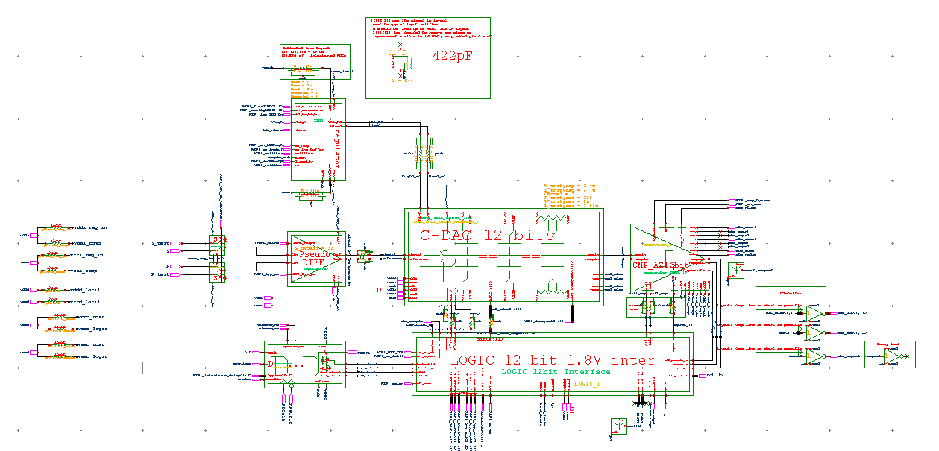
SAR ADC Caeleste implementation generation 9
R
S
Local regulator
ADC
120MHz
24clks
5MHz sampling
CDAC
Input buffer
Comparator
Logic part

Slide 15
SAR ADC group of 8 interleaving
8*5MHz sampling = 40MHz sample rate ADC
R
S
R
S
R
S
R
S
R
S
R
S
R
S
R
S
ADC
120MHz
24clks
5MHz sampling
ADC 120MHz
24clks
5MHz sampling
ADC 120MHz
24clks
5MHz sampling
ADC 120MHz
24clks
5MHz sampling
ADC 120MHz
24clks
5MHz sampling
ADC 120MHz
24clks
5MHz sampling
ADC 120MHz
24clks
5MHz sampling
ADC 120MHz
24clks
5MHz sampling
ADC clock 120MHz
Interleaved 3clocks
Interleaved 3clocks
Interleaved 3clocks
Interleaved 3clocks
Interleaved 3clocks
Interleaved 3clocks
Interleaved 3clocks
240MHz LVDS [DDR]
AD conversion rate is 120MHz / 3
[120MHz/3]*12bit = 480MHz
Or 240MHz DDR

Slide 16
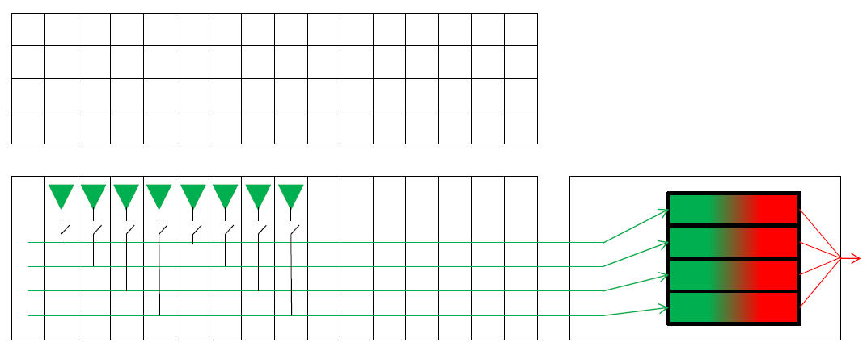
Interleaving/interleaving
As in NOTEBOOK 0032:
Interleaving ADCs is especially convenient if one can combine it with an interleaving video bus.

Slide 17
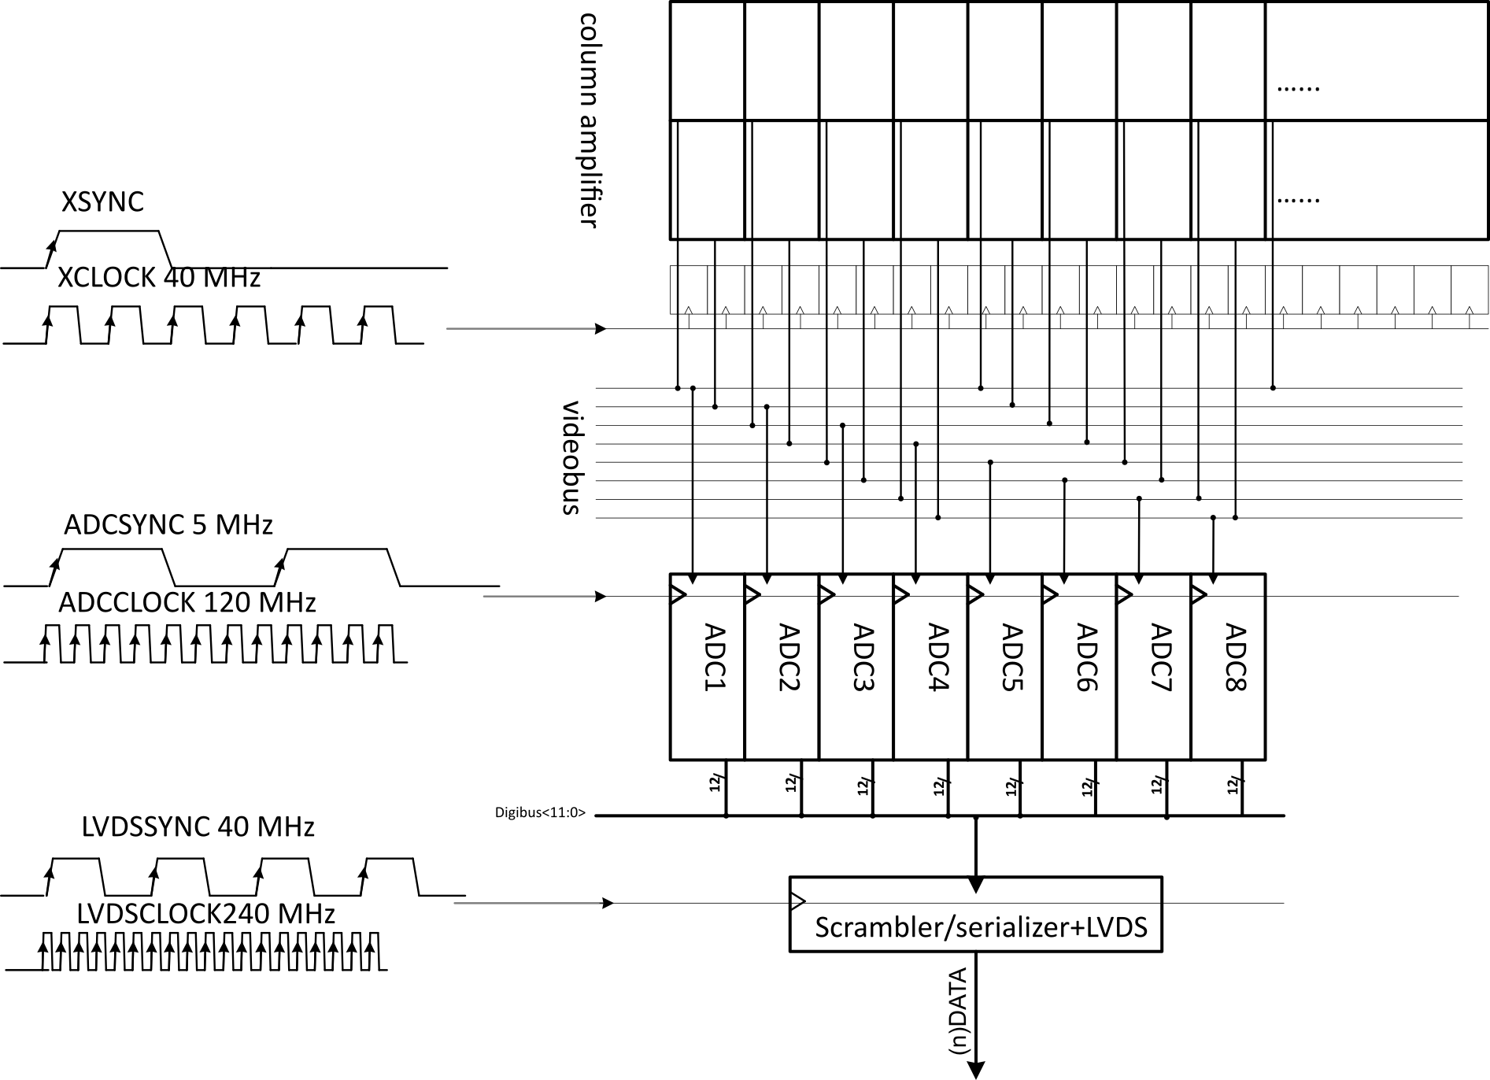
SAR ADC interleaving matched to X-scanner
Symbol | Value | Unit
(n)XCLOCK | XCLOCK | MHz
(n)XSYNC | At the start of every row | XCLOCK periods
(n)ADCCLOCK | XCLOCK * 3 | MHz
(n)ADCSYNC | XCLOCK * 0.125 | MHz
(n)LVDSCLOCK | XCLOCK * 6 | MHz
(n)LVDSSYNC | XCLOCK | MHz

Slide 18
SAR ADC Interleaving settings
Programs interleaving of the 8 ADCs
Default: 8 clocks
Interleave_timing<0:3> | SPI Register | Data Bit | Function
0b1111 | 95 | 12:15 | 16 clock cycles per conversion (8-bit mode)
0b1011 | 95 | 12:15 | 24 clock cycles per conversion (12-bit moden nominal)
0b0011 | 95 | 12:15 | 32 clock cycles per conversion (14-bit mode = 4x oversampling)
0b0000 | 95 | 12:15 | 48 clock cycles per conversion (16-bit mode = 16x oversampling)

Slide 19
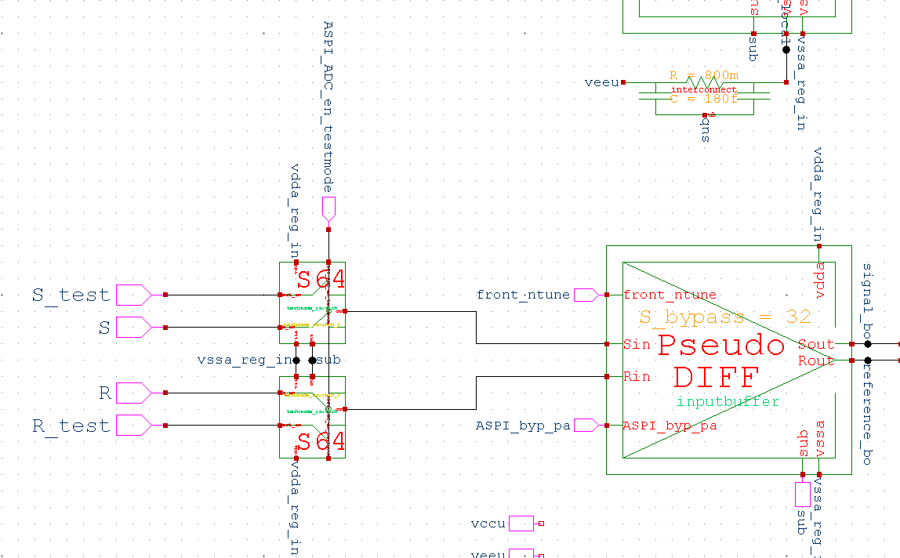
SAR ADC input
VB
In some cases 8 separate pairs.
In other cases all 8 shorted together [S,R]
In some cases available as test points towards the “BP_ADC_test_reset and BP_ADC_test_signal”

Slide 20
CDAC concepts

Slide 21
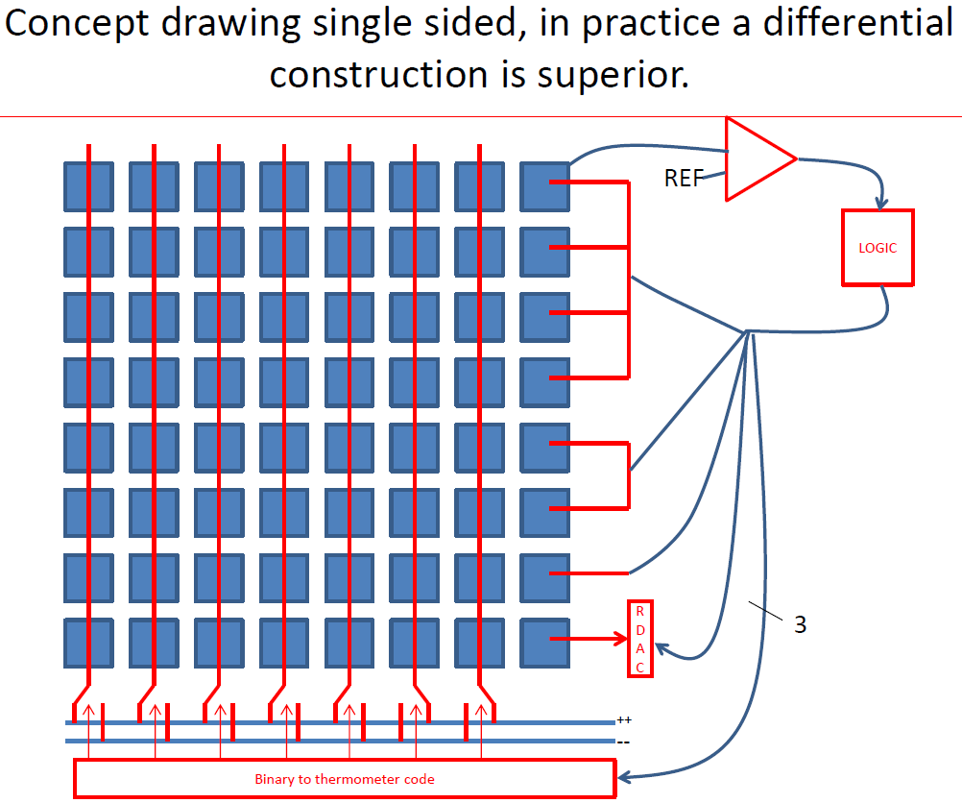
CDAC hierarchy
Original concept from Notebook 0022→
The most significant bits are a “unary” = “thermometer code driven” capacitor bank
The medium bits are a classic “binary” capacitor bank.
The least significant bits are a single unit capacitor driven by a RDAC.

Slide 22
The “unit capacitor” approach
The CDAC is built on unit capacitors
They must be all matched, however the “unary architecture” relaxes this requirement.
For layout matching there is a single ring of dummy unit capacitors around
The number of unit capacitors.
In a U6B2R4 (Unary 6 bits, Binary 2 bits, RDAC 4bits) the number of unit capacitors is 64*4, not counting the dummy capacitors
The total input capacitance are for each input, seeing this number all in parallel.
One desires a total ADC input capacitance
Not too high, for power, crosstalk, area
Not too low, so as to keep kTC noise low.
Example: In ATON they were 2x2µm², “POD” type, having a value of 20fF per unit cell. The ADC pure input capacitance not including parasitics and dummy capacitors is then (64*4*20fF=) 5.1 pF per input.

Slide 23
(not) equal speed in unary/binary/RDAC
Ideally they should all have the same settling speed.
Pro: fastest in “normal” (raw) operation
Con: short glitch when crossing a boundary double conversion.
Problems
Switches see unequal loads in binary.
Extra gate delays in unary versus binary versus RDAC
Realistic (fast, compact) thermometer decoders have unequal speeds for different transitions.

Slide 24
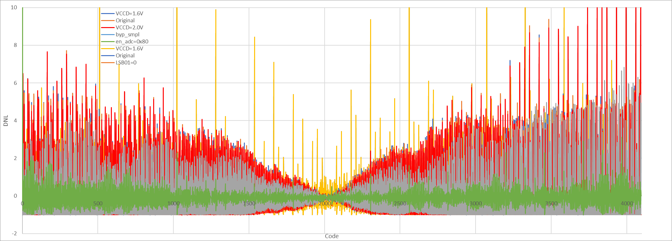
Noise and DNL minimum phenomenon
Noise (rubbish of all kinds) that is present on the difference between HIGH/LOW reference voltages is minimal at midscale.
The reason is that at midscale the HIGH/LOW difference impacts each of the differential comparator inputs in an equal way.
Measured on ATON 202207

Slide 25
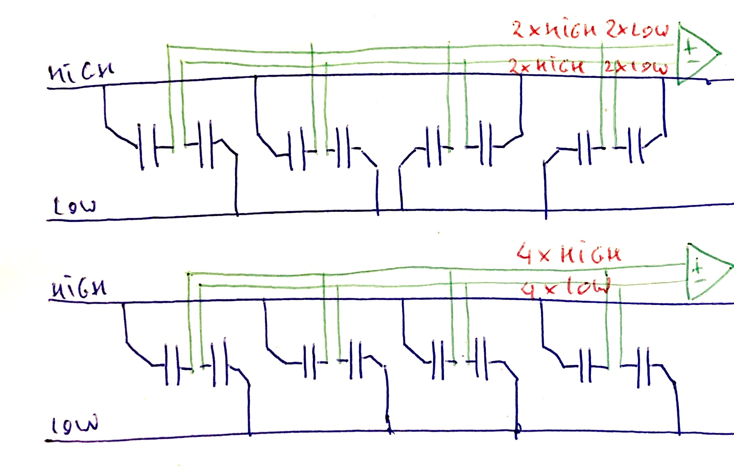
Origin of the noise minimum
At midscale, an equal number of unit capacitors hangs on HIGH and LOW, as seen by each comparator input.
Towards scale extremities, each comparator input node sees capacitors connected all to either HIGH or LOW.

Slide 26
Noise and DNL minimum shift
Noise (rubbish of all kinds) that is present on the difference between HIGH/LOW reference voltages is minimal at midscale.
The reason is that at midscale the HIGH/LOW difference impacts each of the differential comparator inputs in an equal way.
One can make use of that: add extra capacitance asymmetrically to the comparator input nodes. In Balor and Aton, one used the dummy capacitors for that.
this method has a drawback: the input capacitance increases.
Other drawback: the CDAC adjustment range drops below HIGH-LOW.
A further variant method (“split capacitor”) does not have these drawbacks. See further.
In Aton one observed this shift of the minimum, but the minimum did not improve the noise level of the baseline. Possibly the improvement was masked by another larger effect.

Slide 27
Comparator

Slide 28
(Not) clocking the comparator (except its latch)
The ATON comparator was made programmable to be used both as
Preamplifier and gain stages clocked = reset prior to conversion
Preamplifier and gain stages not clocked = continuous time comparators
The end latch is always clocked.
Pro clocking:
should settle faster when large polarity change.
Pro not clocking:
eats up analog settling time (hypothesis not proven)
Clocking undos the calibration (offset cancellation) as the equilibrium of reset is not the same as equilibrium of calibration.
In ATON was experimentally verified that when not clocking, there were significantly more glitches.
(from Notebook NCR07 Aton debugging)
Conclusion: keep the programmability to chose between clocking and not clocking. As tradeoff not fully understood.

Slide 29
V_{HIGH} and V_{LOW} regulation

Slide 30
CDAC’s HIGH and LOW reference
In BALOR, ATON, ELFIS2, LARADIS, on-chip regulation options exist per elementary ADC
The unregulated VDDU can be regulated down to a HIGH, the VSSU is then used as LOW.
Following programmable modes exist:
Bypass, i.e. the VCCU is used as HIGH reference, via a switch in each unit ADC.
Feedback SF regulation: the local HIGH is made equal to a reference by feedback.
Feed Forward (FF) regulation, referencing a dummy SF regulator stage. It does not feedback, but it compensates for temperature etc.
The SF is directly driven from a DAC voltage. Same as FF, but there is no temperature and process compensation.

Slide 31
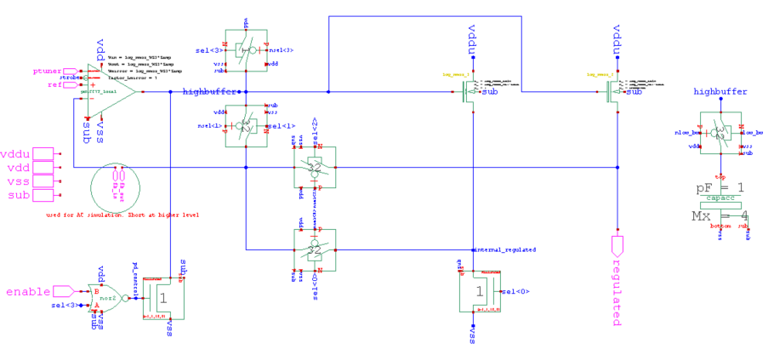
Regulator Modes of operation
Feedforward mode (FF)
DAC + buffer drives the SF gate (UG Buffered)
Feedback over SF (Full Regulator)
Bypass (SF as switch fully on)

Slide 32
VDDU / VSSU network
In order to limit the “IR drop” generated crosstalk, two viewpoints:
VDDU/VSSU (or VCCU/VEEU) wires are separated per [interleaving] phase (i.e. elementary ADC) and joined at the bondpad (as in Balor, Laradis…)
Have a single low impedance track (as in Aton). A simple design, and an unquantified risk on phase to phase crosstalk.
Furtheron we will discuss possible further improvements to limit phase to phase crosstalk.

Slide 33
Double conversion and postcorrection

Slide 34
What is “double conversion”
Double conversion is an “unsupervised error correction mechanism”.
Suppose that the ADC makes a (dynamic or static ) error at some bit. Subsequent lower bits can never fully correct the error, by nature of the basic SAR principle.
Our solution is to allow (a number of, statically programmed) bits to act twice, each time having a conversion that can eventually result in twice that bit being 1 or 0 in the converted digital value.
This will be realized as an adder that receives the bit value twice, either in upward counting or downward counting mode.
The method allows to cross the major bit boundary by lower bits.
The method is intended to reduce large conversion errors.
At run time one can program the ADC to have such double conversion on any bit position. Of course, if you do this for every bit, the conversion time will almost double. In reality, one will choose the bit position where double conversion is foreseen carefully.

Slide 35
What is postcorrection
Postcorrection is a double conversion on the LSB. It can happen multiple times.
Postcorrection is also a non-supervised error correction method.
After the regular (e.g. 12bit) ADC conversion cycle, one might not effectively have reached the ideal ADC output value. If this happens at random output codes, we speak about noise. If this is systematic for certain output codes, we call it “large DNL” or “code gap”.
Such code gap is solved after the regular conversion by executing a series of comparisons, and acting by adding or subtracting one LSB to the end result. This solves code gaps and should improve DNL and noise, as far as it is not due to mismatch inside the CDAC.

Slide 36
The odd/even effect of postcorrection
As postcorrection adds or subtracts a +1 or -1 to the regular ADC result, it will have only odd or only even results, depending the number of postcorrections, only depending if the regular result was odd or even.
Also the regular ADC converted result (without postcorrection) suffers from this odd-even effect. This is a major FLAW of our ADC.
This increases the random noise of the end result.
It also degrades the result if one would use the series of postcorrected results for oversampling.
A number of tricks has been proposed to remove the odd even effect AND reduce the associated discretization noise.

Slide 37
The odd-even effect, countermeasures
Our SAR ADC in simple operation (raw mode without double conversion and without postcorrection)
has an odd-even effect
the solutions implemented and preferred (since Balor) are
Alternating between up/same and same/down
For the last conversion, and for each subsequent postcorrection
A better root cause solution was implemented since Generation 8 (2021 ELFIS2) (is that true?)
Q: what is the baseline? (Cfr Nitara / Amir?) please document here.

Slide 38
Oversampling

Slide 39
Oversampling concepts
Actual concept, used in BALOR a.o.
A separate 16 bit adder accumulates 4 or 16 values coming out the ADC while postcorrecting.
Assuming that postcorrection results are uncorrelated results of the AD conversion (which they are not!), the average has less noise.
Alternate concepts, not elaborated:
Register and readout the last N comparator bits, so that off-chip the intermediate values can be reconstructed.
Other methods see under future improvements

Slide 40
int2float
A subcircuit that converts in a combinatoric fashion a 14bit integer to a 12bit float

Slide 41
INT2FLOAT
The ADCs of LARADIS and ELFIS2 both have a INT2FLOAT encoder acting on the 14 MSB of the 16 bit oversampler.
See Notebooks 0226 and 0328, also 0571
Project SENSATION
In project SENSATION the Laradis ADC was tested in 4x oversampling (14bit mode) and 16x oversampling (16bit modes).
In both cases the 14 highest bits are encoded to 12 bit words and expanded at the computer side to the original 14 and 16 bits. Results were reported in the Sensation WP3, D3.6, Final evaluation report, Version 1.0, 17-06-2021

Slide 42
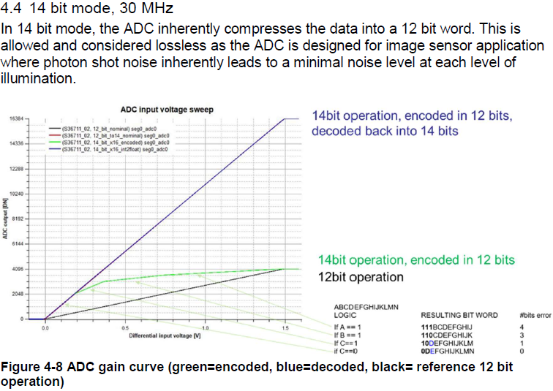
14bit mode
From report

Slide 43
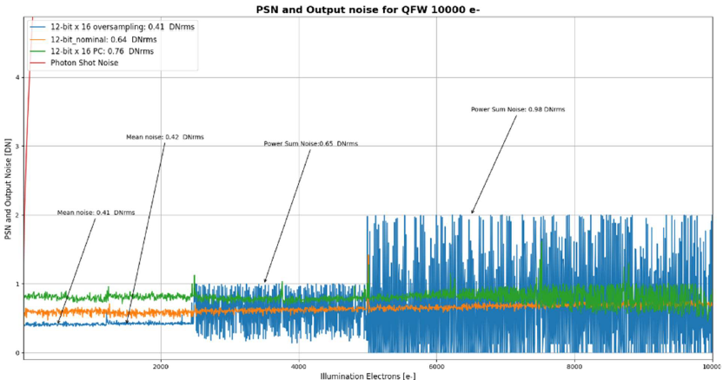
16x oversampling, read out via int2float
Conclusion: (this way of) oversampling is barely worth the effort.
Vernier or alike is more promising
From report. Oversampling results in baselevel noise going from 0.64DN (nominal) to 0.41DN.
This is a very modest noise reduction. The discretization limit would be 0.23DN, the effect of perfect uncorrelated oversampling would result in 0.16DN

Slide 44
Array issues

Slide 45
Array issues
In practice, the issues encountered with image sensor on-chip ADCs are related to the fact that there are many more than one in an intensily connected network.
A single ADC may work fine, in an array of such, inter-ADC crosstalk results in significant noise and artifact increase
This problem applies to all types, such as Ramp ADCs, SAR ADCs…
Most root causes are related to the common nodes (supplies, substrate, biasing)
The other causes may be due to “plain” crosstalk between e.g. digital parts and analog parts.

Slide 46
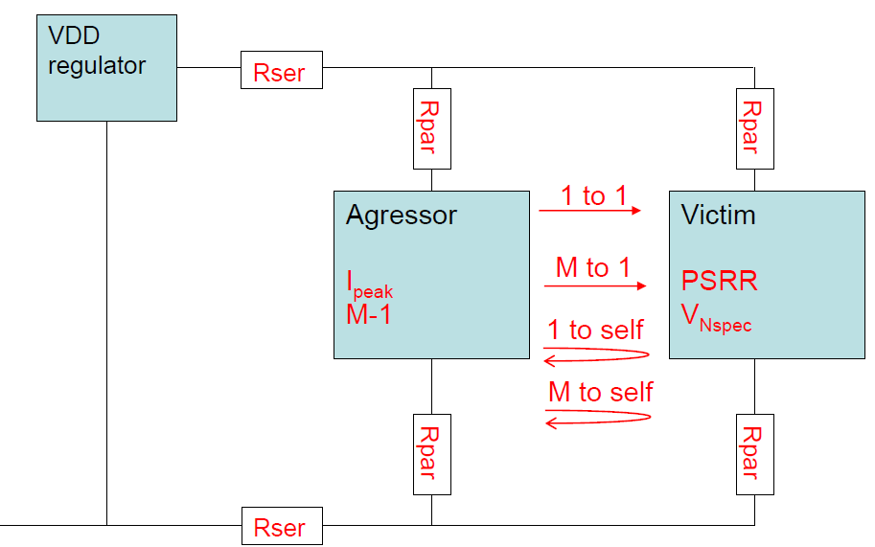
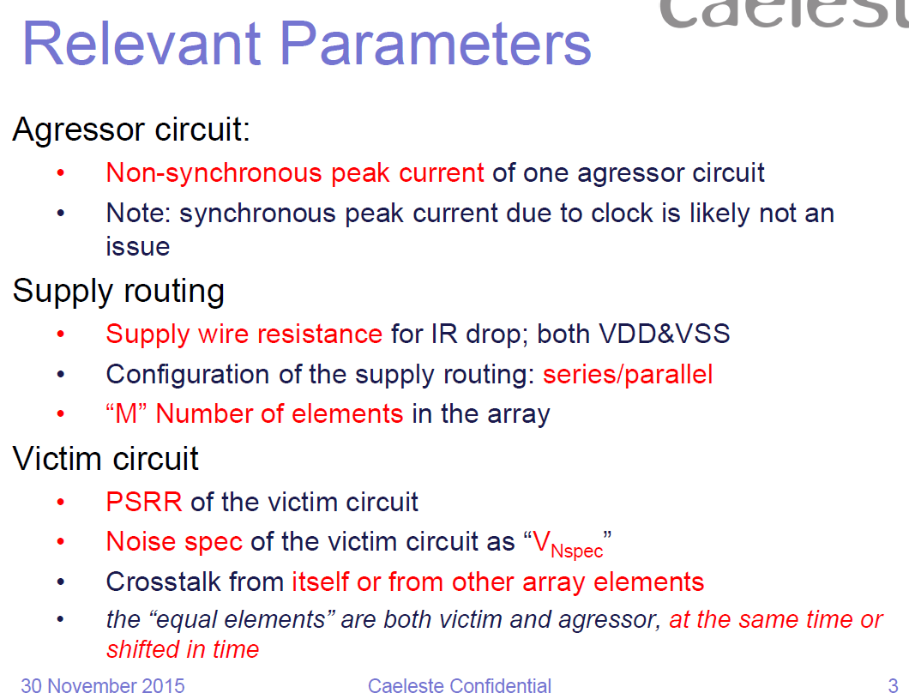
Arrays issues (general concepts)
<<< insert here relevant parts of notebook 0124>>>

Slide 47
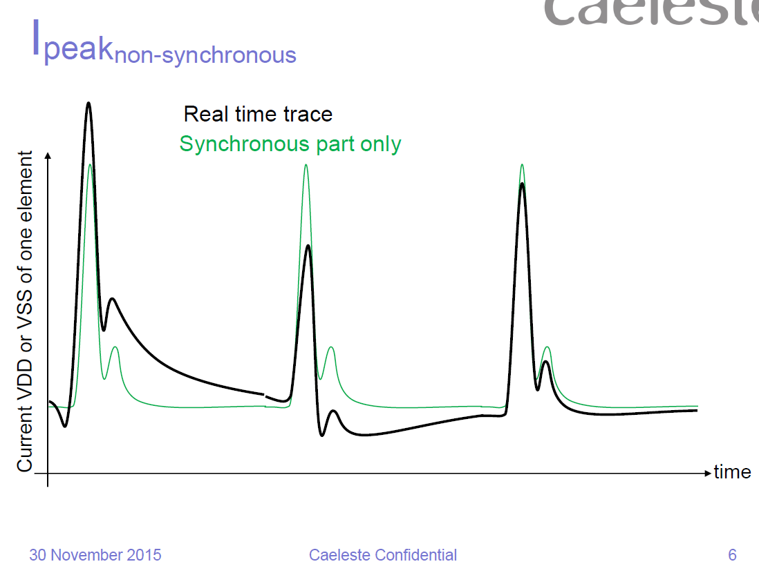
Not all crosstalk is adverse
There is a fundamental difference between
Synchronous, reproducible crosstalk
Signal dependent crosstalk
Random crosstalk
Understand this difference in prioritizing counter measures.
harmless
hurts
noise

Slide 48
Radiation tolerance

Slide 49
Radiation hard
The same approach as in image sensors is adhered.
Approach
TID hard layout
DICE in the static ASPI registers
Not DICE nor TR for the fast in-ADC registers
Thus an event in one of these might result in a one-code error, similar to a large conversion error.
If really wanted, one can equip also the internal fast registers and latches with DICE, making these slower.

Slide 50
Possible future improvements
In the binary SARADCs
Advise to do in next generation
Should not do

Slide 51
Update RDAC
To be done for Flames
Bottom switch NMOS only, this simplifies the design of the decoder.
Advise: make all switches same nature as for the unary&binary CDAC.
UNLESS split capacitor method used which demands FAST switches
BUT
Will definitely not do if split capacitor is done.

Slide 52
Timeconstant of RDAC
The RDAC in series with a unit capacitor should be given a timeconstant as short as the other switches.
If not, one will see a vulnerability to VHIGH-VLOW noise.
Advise: reduce R of RDAC proper
Parallel resistor (MOSFETs) does not make sense.
20230502ba

Slide 53
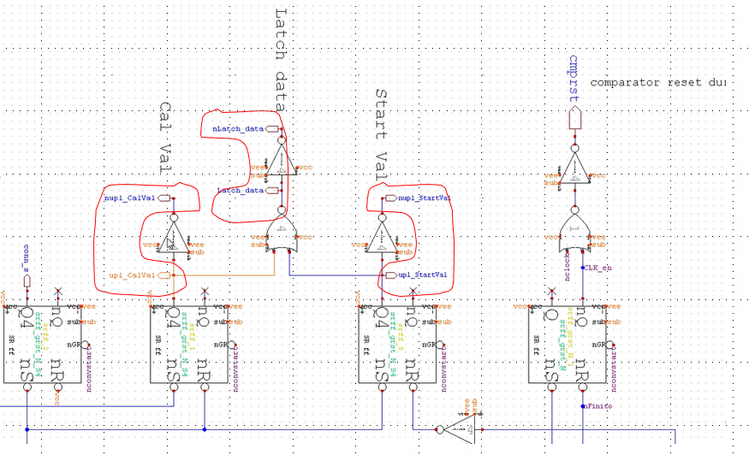
In sequencer: symmetric controls
Make these internal controls symmetric by using invninv_core instead of just inverting.
(from Notebook NCR07 Aton debugging)
To be studied if really necessary.
If so, as circuit cost is marginal, consider in next generation

Slide 54
Dummy caps used as decoupling
Should not load the output of the regulator, or at least be disconnectable.
Should not load the input nodes of the comparator, or at least be disconnectable.
Advise: use single band of dummy connected to ground. Do not use for decoupling.

Slide 55
also
do
Hardwire startval on 100000000000
Overload calval with teachcodes
do

Slide 56
HIGH and LOW reference regulation
This is about interleaving ADCs (when not interleaving, some aspects change)
On-chip per ADC regulation options
Bypass, i.e. the VCCU is used as HIGH reference, via a switch per ADC
Feedback regulation.
Feed Forward (FF) regulation, which compensated for temperature etc.
DAC to SF, same as FF, but SF is directly driven from DAC voltages.
When doing so, VCCU and VEEU
Can be separated per [interleaving] phase and joined at the bondpad (as in Balor, Laradis…)
Have a single low impedance track (as in Aton)
Collective regulation options
All HIGH and LOW are shunted, pretty low impedance, decoupled at bondpad
LOW is de facto equal to VEEU
There may be a regulation VCCU to HIGH
On-chip, at the HIGH bondpad
Distributed over all ADCs
Abandon in-ADC regulation
Conclusion
In general a preference to move completely to “split capacitor” as Notebook 0621

Slide 57
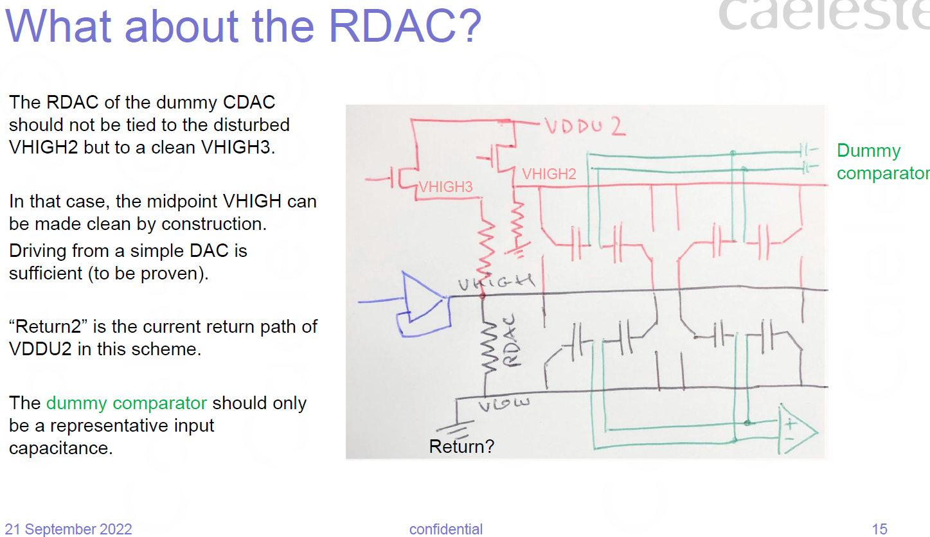
Notebook 0621: Compensation of glitches in HIGH reference
As in notebook 0621→
This makes sense if the regulation is on-chip and imperfect.
This drawing leaves open
HIGH not shunted amongst ADCs
HIGH shunted amongst ADCs
The last case resembles the previous slide.

Slide 58
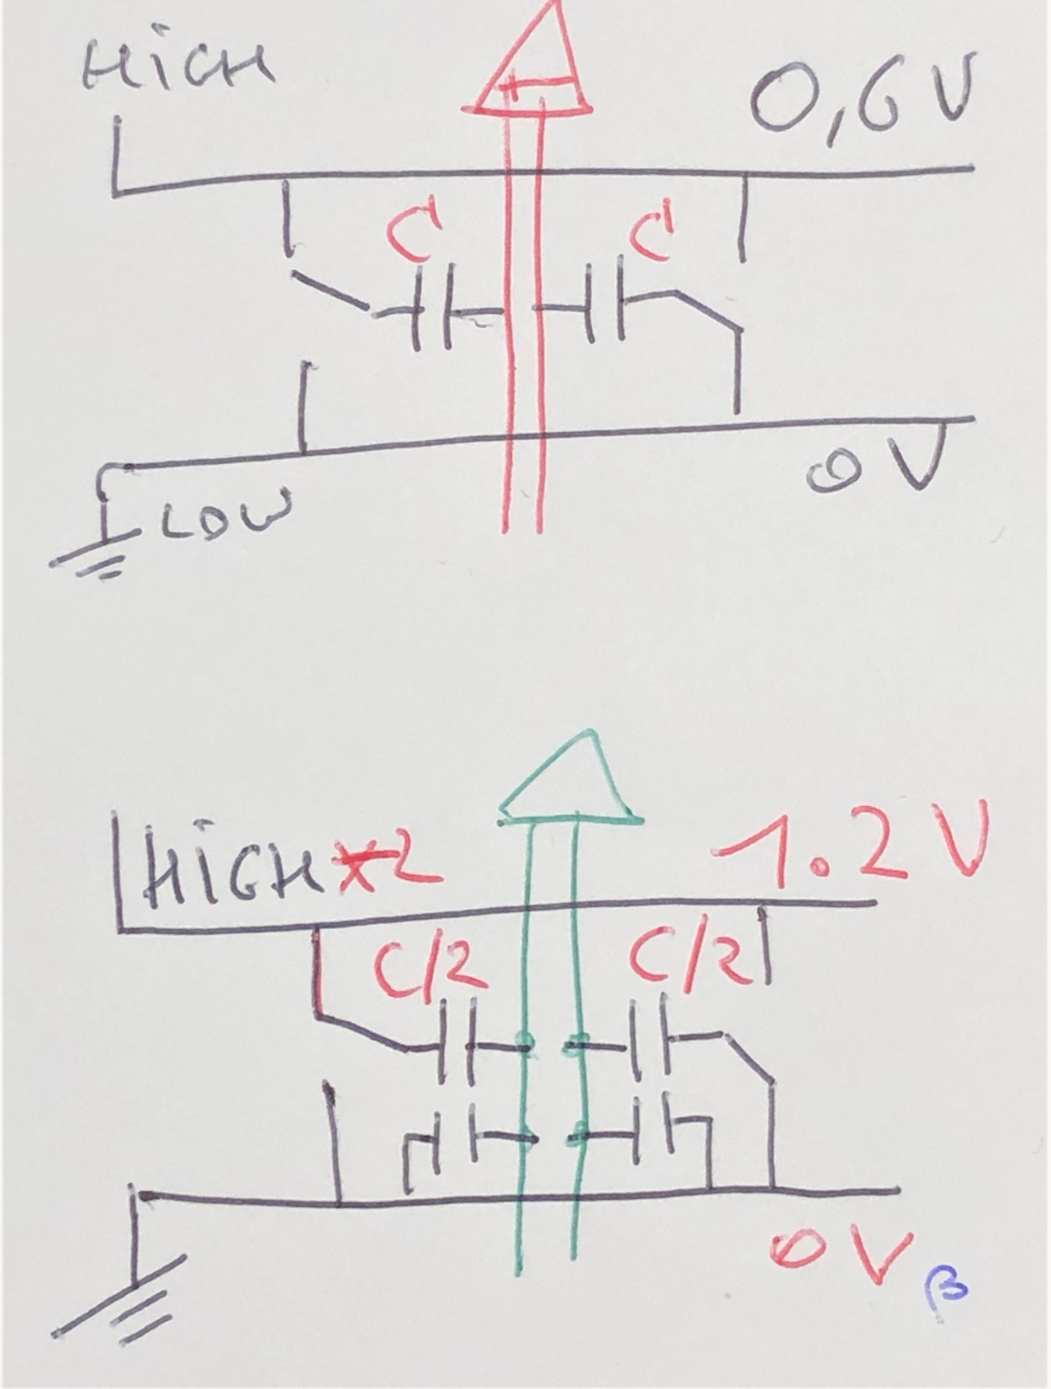
Reduce reference voltage sensitivity by split capacitor
Above: concept drawing of differential capacitance on the input wires of the comparator
Below: each capacitor is split in two, of which
One half is tied to LOW (GND)
One half is tied to a new “HIGH” reference, that has 2x larger voltage.
This construction makes the impact of noise/rubbish on the HIGH reference twice as low.
Can do that if HIGH-LOW is indeed low.
Why not: 3x0.6V=1.8V
To try out: can this be combined with the dummycap asymmetric connection for noise minimum without its disadvantage. Next page
Can be combined with collective regulation
Propose to use in next generation (+next page)

Slide 59
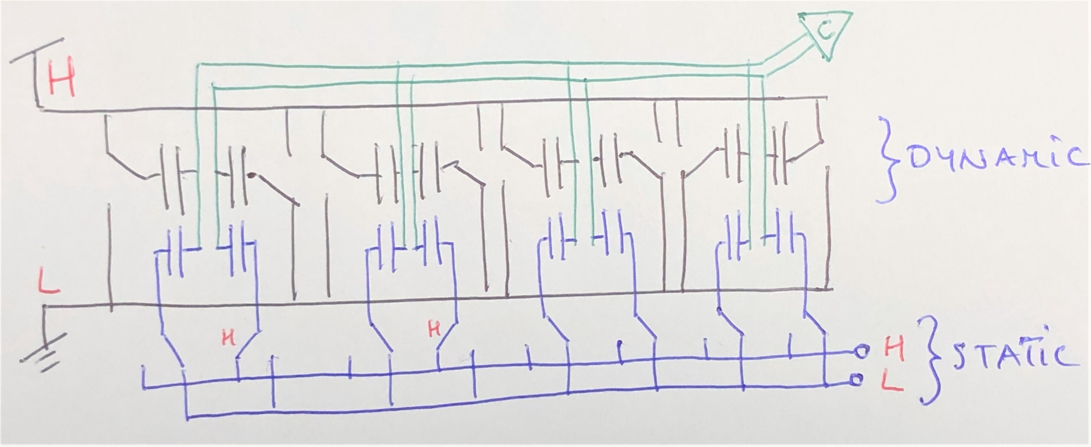
Combination of split capacitor and noise minimum shift.
This is a variant on the noise minimum shift. In this embodiment, the disadvantage of increased capacitance and less adjustment range is not present. None or one of the split capacitor pairs is connected to HIGH or LOW reference in a static way. If you want the noise minimum to happen at 10% of range, one needs to tie half of 80% of the extra caps to HIGH, statically
Propose to use in next generation

Slide 60
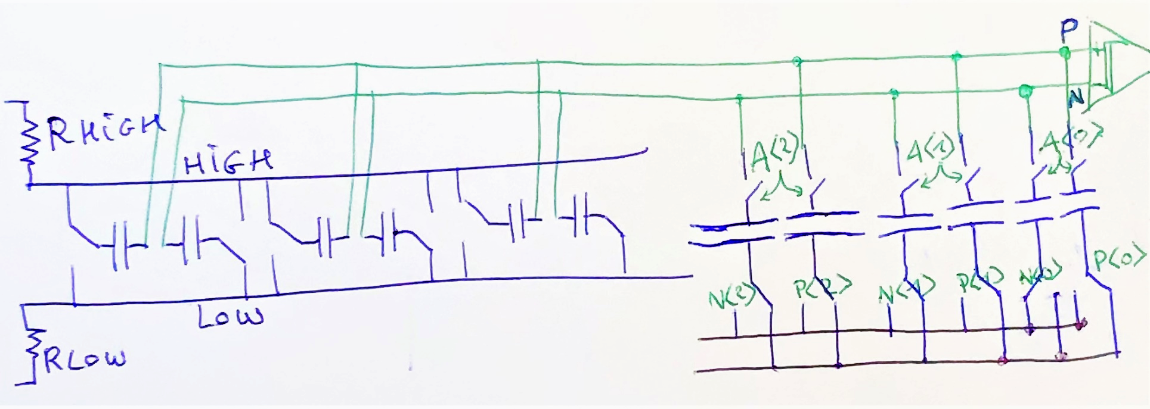
Further evolution of the previous see Notebook 0635
Apply 1.8V VHIGH, directly on bondpad
Perhaps one can put a regulator on the bondpad. Perhaps just rely on outside regulated quality
Downconvert to 0.6V range by adding the {1/3 normal} + {2/3 parallel} C on the comparator input nodes.
Allow noise minimum shift by having bottom plates to HIGH or LOW reference programmable.
And also
Make the downconversion programmable by making the extra caps connectable in binary fashion
Less downconversion (lower gain) goes with lower input capacitance (faster, noisier) and lower resilience against HIGH-LOW rubbish.
1/3 of total Cin
2/3 of total Cin
Caveat also
This ressembles the dummycapacitor network as present in generations 8, 9. Do not make same mistakes.
connect_*<2:0>
C<2>
C<1>
C<0>
Will use in non-binary
1 ½ ¼
HIGH
20221226ba last update
LOW

Slide 61
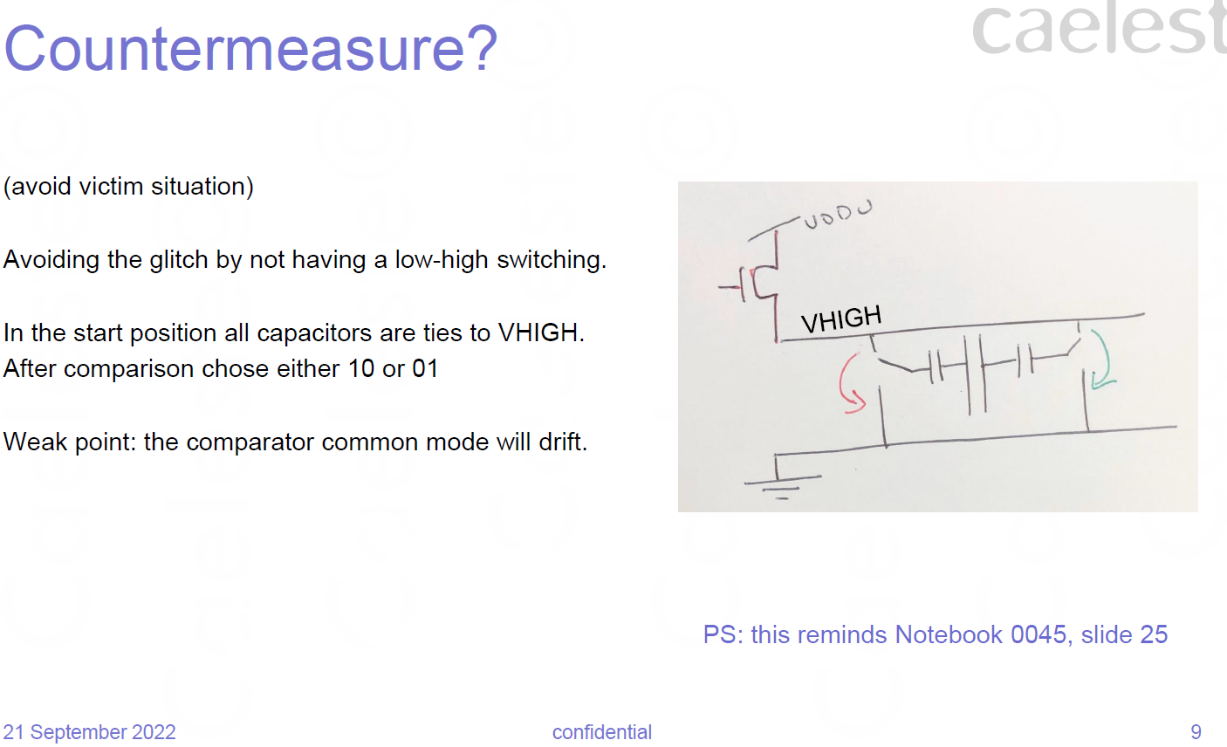
Single direction CDAC switching
As suggested in Notebook 0621
Will do this in non-binary

Slide 62
Toplevel register loops
Rethink the toplevel, and improve the imperfections of the two critical loops digital / analog

Slide 63
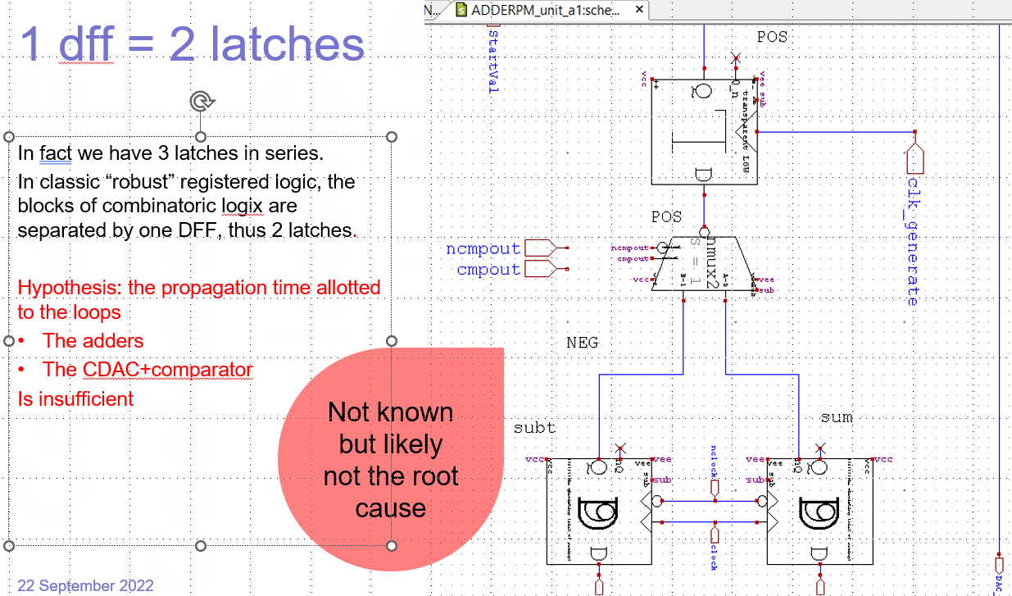
Rethink the two register loops
(from Notebook NCR07 Aton debugging)

Slide 64
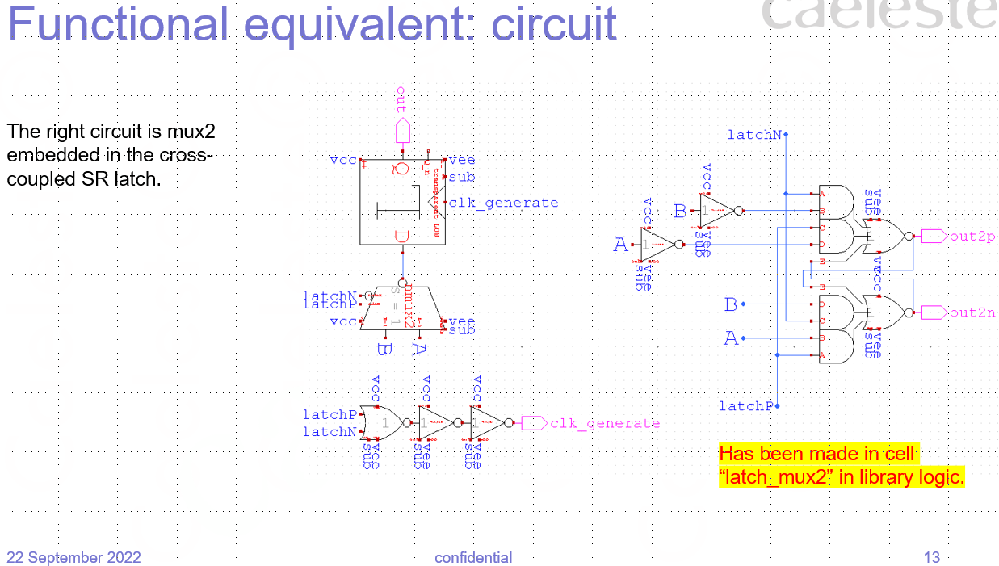
Avoid making/using clk_generate
from Notebook NCR07 Aton debugging→
See also Notebook 0624
Concept imperfect as failure modes possible. I.c. if pulse is very short, not all bits may be updated.
Probably need to gate latchN/P with the comparator clock.

Slide 65
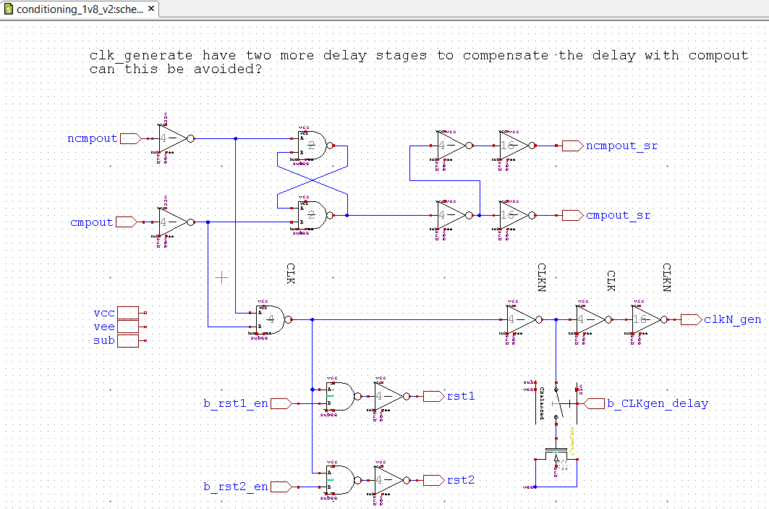
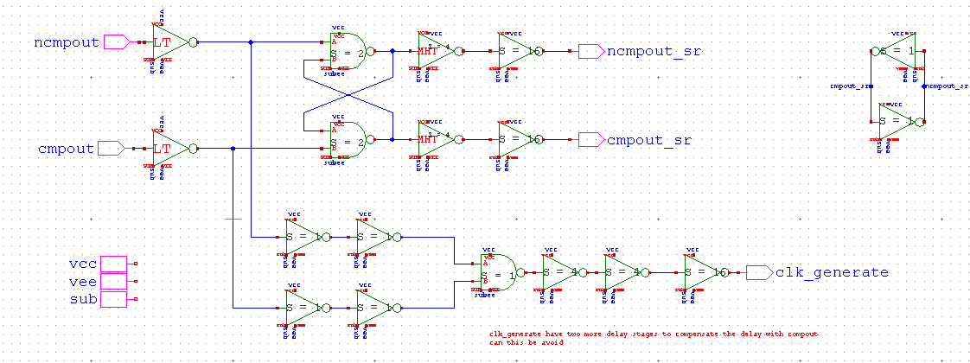
Simplify this part?
“conditioning” following the comparator latch.
The above is ATON, the below is BALOR. Speed improvements indicated with x
As the relative timing does not matter, why not even the below?
Irrelevant in comparison to other propositions

Slide 66
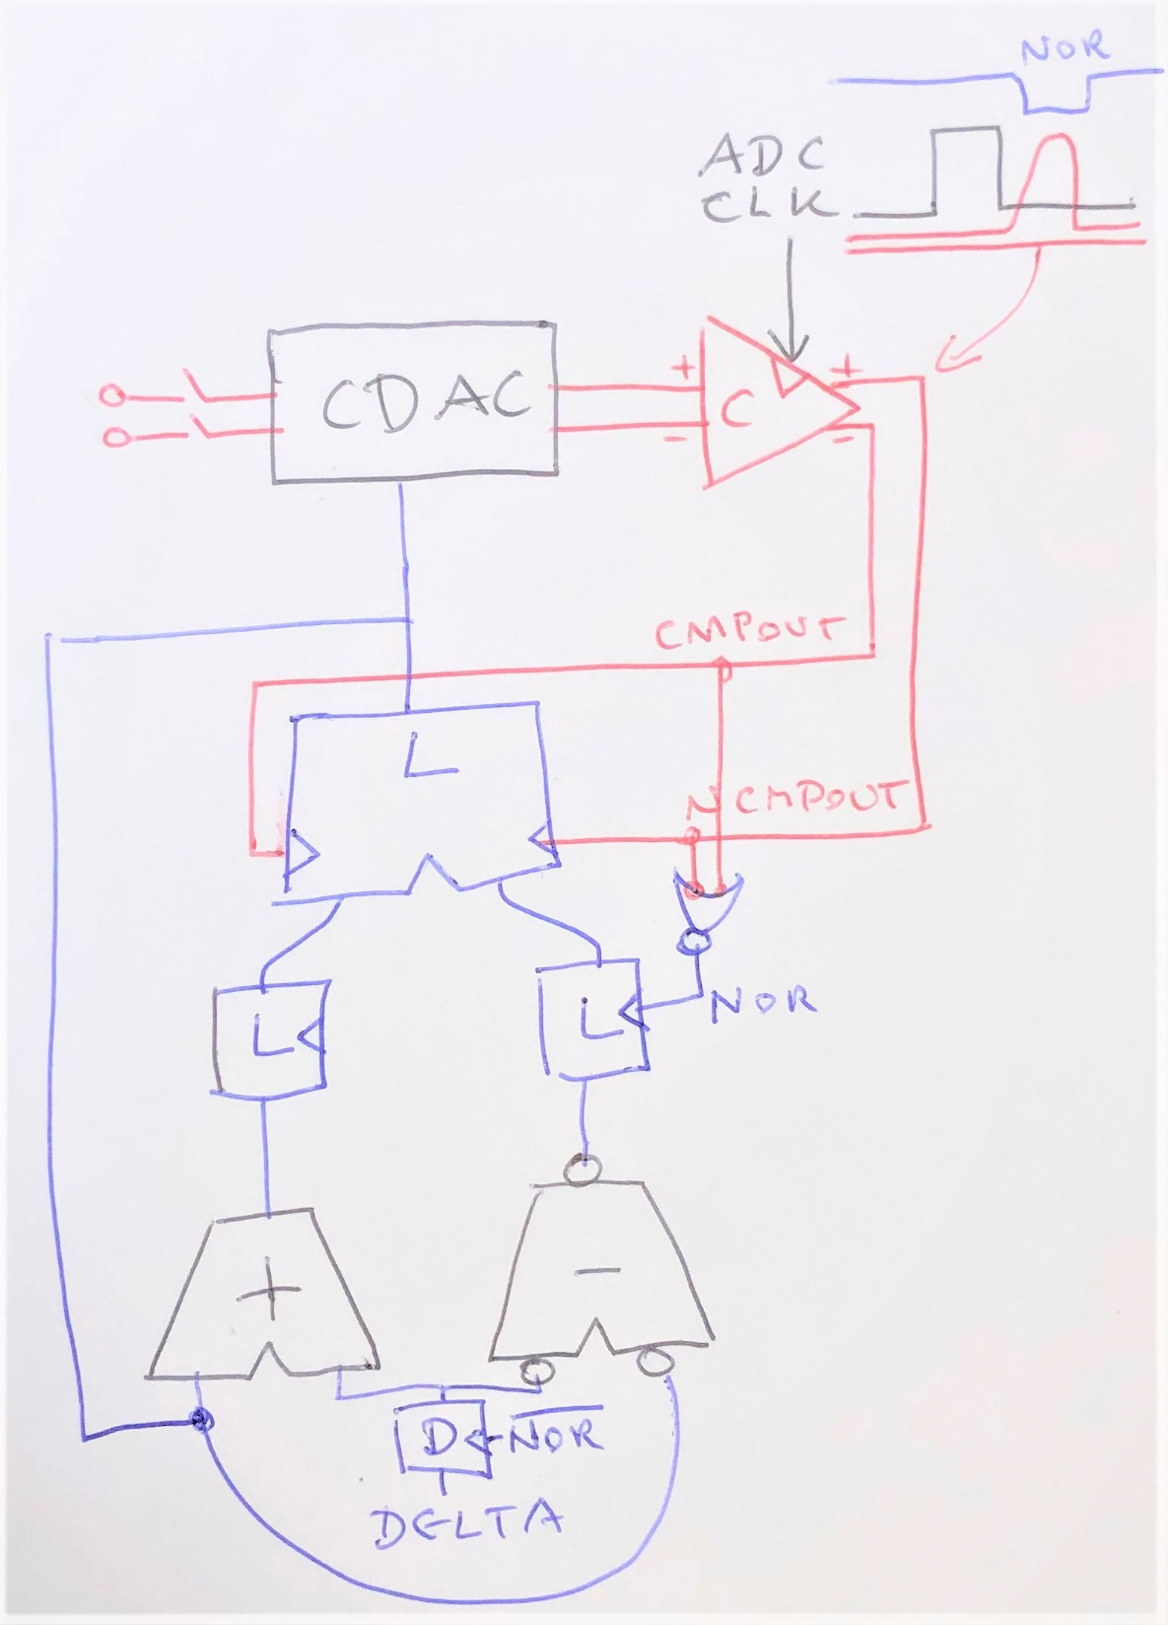
Topology with 2 latches in each loop.
From Notebook 0624:
Configuration where both analog and digital loop have two latches.
Here a small modification, both the Latch after the adder and the comparator latch receive the bare ADC clock.
X
X ADC CLK
First prove by simulation that it is really better, then use in next generation

Slide 67
Odd/even effect
Hypothesis, countermeasure

Slide 68
What happens? And first countermeasure
One needs 11 comparisons to reach the LSB, and then?
Each next bit is incremented with +1 or -1, and one chooses the one corresponding to the comparator.
The LSB value would need an addition starting at an imaginary LSB+1 (1/2 bit value)
However, instead, one simply can copy the comparator output into the LSB, not needing an addition.
100000000000 startval
110000000000 ←chosen by comparator 1
010000000000 added or subtracted MSB-1
111000000000
101000000000 ←chosen by comparator 0
101100000000
100100000000 ←chosen by comparator 0
...
110001100110 ←chosen by comparator 1
010001100010 added or subtracted 10
110001100111 ←chosen by comparator 1
110001100101 added or subtracted 1
1100011001111 ←outcome comparator 1
1100011001101 LSB=comparator outcome
Acknowledgment: this is an older idea by NN

Slide 69
The same with postcorrection
We start at LSB-2 conversion and then continue with a number of postcorrections.
Yet for ADCout we keep the previous value and put the comparator output on LSB position.
110001100110 ←chosen by comparator 1, added 10
010001100010
110001100111 ←chosen by comparator 1, added 1
110001100101
110001101000
110001100110 ←chosen by comparator 0
110001100111 ←chosen by comparator 1
110001100101
110001101000
110001100110 ←chosen by comparator 0
110001100111 ←chosen by comparator 1
110001100101
110001100110
110001100111
110001100110
110001100111
This seems as well an odd-even effect, but it is not.

Slide 70
Countermeasure implementation?
With minimal changes in the present ADC one could do:
Upload the previous value of the adder/subtractor.
May need extra dff tapping the CDAC input.
Yet replace the LSB with the comparator output for the next change.
This may be unconditional, just do it always, either for raw conversion or postcorrection.
BTW in any normal operation, one always reaches the LSB, so no special precautions for non-LSBs are required.
DN<11:1>
L
DN<0>
ADC CLK
70

Slide 71
Countermeasure valuable?
110001100111 ←previous value
110001101000 ←result LSB+1
1100011001111 ←result as if LSB½+1
110001100111 ←LSB=comparator outcome
110001100111 ←previous value
110001100110 ←result LSB-1
1100011001101 ←result as if LSB½-1
110001100110 ←LSB=comparator outcome
110001101000 ←previous value
110001101001 ←result LSB+1
1100011010001 ←result as if LSB½+1
110001101001 ←LSB=comparator outcome
110001101000 ←previous value
110001100111 ←result LSB+1
1100011001111 ←result as if LSB½-1
110001101000 ←LSB=comparator outcome
“old” postcorrection means LSB increment or decrement
LSB½ increment/decrement is assumed a better way.
Hypothesis: the same result is obtained by copying the comparator output into the LSB?
Assuming that the LSB½ is the “best” or “most accurate” approach, then
Old postcorrection gives the same result in half the cases, 1 LSB difference in the other cases.
And just as well copying the comparator output gives the same result in half the cases, 1 LSB difference in the other cases.
Thus, apart from removing the odd/even, this countermeasure has no added value.

Slide 72
Solve odd/even in extra ½ conversion onlyup/onlydown
110001100111 ←previous value
110001101000 ←result LSB+1
1100011001111 ←result as if LSB½+1
110001100111 ←LSB=comparator outcome
110001101000 ←result LSB+1
110001100111 ←previous value
110001100110 ←result LSB-1
1100011001101 ←result as if LSB½-1
110001100110 ←LSB=comparator outcome
110001100111 ←result LSB-1 not decrementing
110001101000 ←previous value
110001101001 ←result LSB+1
1100011010001 ←result as if LSB½+1
110001101001 ←LSB=comparator outcome
110001101001 ←result LSB+1
110001101000 ←previous value
110001100111 ←result LSB-1
1100011001111 ←result as if LSB½-1
110001101000 ←LSB=comparator outcome
110001101000 ←result LSB-1 not decrementing
Shown here: after the “normal” +/-1LSB conversion,
We do one next comparison, but allow only the LSB to increment, or stay the same.
The result is equivalent to +/- LSB½ (apart from 1 LSB offset). (PS in fact only decrement would be better)
Thus, in total for a 12bit ADC there are 13 comparisons.
Implement in next generation: Do one extra comparison after +/-1LSB and allow only to decrement.
If postcorrection is kept, do it alternating onlydown / onlyup / onlydown as was already in place.
Thus the LSB is affected TWICE, in different ways!

Slide 73
Amended onlyup or onlydown
Standpoint/hypothesis: the best odd even removal acts “as if” there is an extra LSB/2 being converted.
The “onlyup” or “onlydown” approaches as presently use are good, however in a noise-free situation, one does not use that extra conversion to home in on the final result, and are thus conceptually worse than as if there is a LSB/2.
Assuming that we are in a situation where the next conversion typically overshoots
because of postcorrection
because of non-binary
Then it is statistically better to do
onlyup when the previous conversion was downward
onlydown when the previous conversion was upward.
Sounds good idea, however, it is not clear how to make the circuit. Only do this when limited overhead.

Slide 74
Alternative ways to oversample
In software, off chip

Slide 75
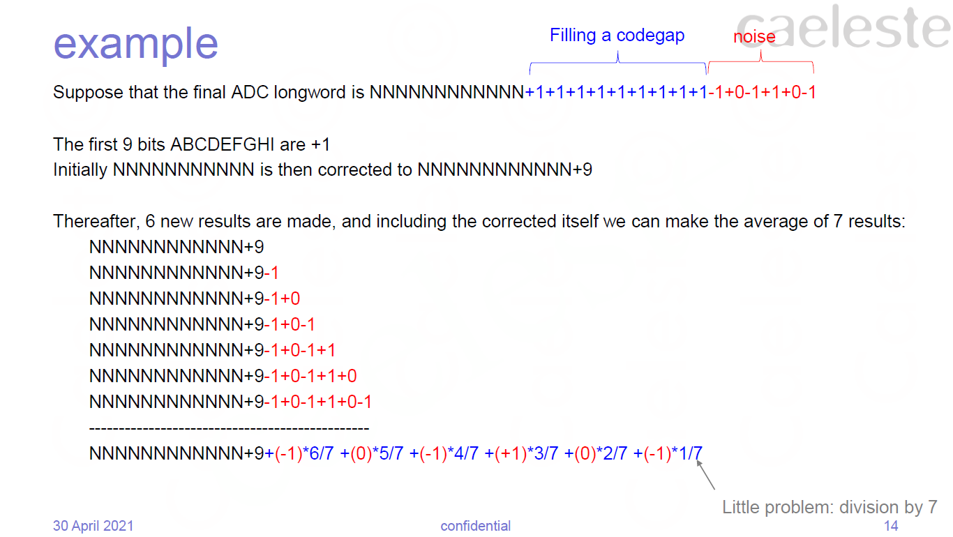
From Notebook 0516: How to average extra postcorrections

Slide 76
Off-chip mitigation of odd/even effect
The off-chip handling of postcorrection can be used to handle the odd-even effect as well.
This allows to have the pure +1/-1 comparator result to be readout as single bits.
Output words NNNNNNNNNN100 +1+1+1+1+1+1-1+1-1+1-1+1
A B C D E F
Reconstructs last 6 codes
NNNNNNNNNN100 this is the final result
NNNNNNNNNN010 minus F
NNNNNNNNNN100 minus E
NNNNNNNNNN010 minus D
NNNNNNNNNN100 minus C
NNNNNNNNNN010 minus B
NNNNNNNNNN011 average
Code gap filling
Noise or odd/even pattern
Flaw: this does not improve noise below 1LSB??
Should be an even number so that a pure odd/even pattern results in half value.
Do not
Vernier is a better concept

Slide 77
Better postcorrection?

Slide 78
Better postcorrection
-1001.111
1000 -
1100 +
1010 +
1001 -
1001.1 -
1010.0 +
1001.1 -
1010.0 +
-1001.111
1000 -
1100 +
1010 +
1001 -
1010 +
1001 -
1010 +
1001 -
-1010.101
1000 -
1100 +
1010 -
1011 +
1010.1 -
1011.0 +
1010.1 -
1011.0 +
-1010.101
1000 -
1100 +
1010 -
1011 +
1010 -
1011 +
1010 -
1011 +
Left: postcorrection as if from an extra LSB-1.
Right: present postcorrection
The better postcorrection gives you one bit more.
1001.11
1001.1
1010.11
1010.1
-1011.001
1000 -
1100 +
1010 -
1011 -
1011.1 +
1011.0 -
1011.1 +
1011.0 -
-1011.001
1000 -
1100 +
1010 -
1011 -
1100 +
1011 -
1100 +
1011 -
-1010.011
1000 -
1100 +
1010 -
1011 +
1010.1 +
1010.0 -
1010.1 +
1010.0 -
-1010.011
1000 -
1100 +
1010 -
1011 +
1010 -
1011 +
1010 -
1011 +
1001.01
1011.1
1010.01
1010.1

Slide 79
vernier
Alternative for postcorrection and oversampling

Slide 80
Postcorrection with a vernier
Idea:
Apply 12 extra comparisons
Do not recalculate the SAR code (or…?)
Vernier (sweep) or Dither (pseudo random) an offset to the CDAC.
Record the 12 extra comparison bits.
May/should span more than one LSB.
Should not even be equally spread.
A vernier with 8 positions spanning one LSB, gives you ideally 3 extra bits.

Slide 81
Vernier 12 points
+10
+1
+0.100
+0.011
+0.010
+0.001
-0.001
-0.010
-0.011
-0.100
-1
-10
+1000
+100
+10
+1.1
+1.0
+0.1
-0.1
-1.0
-1.1
-10
-100
-1000
Very optimistic, assuming that the nominal ADC reaches <0.5 LSB error
LSB
More realistic, assuming that the nominal ADC reaches ~2 LSB error
Last code
LSB
Last code
LSB
LSB

Slide 82
Compressing the Vernier output.
+1000
+110
+100
+10
+1.1
+1.0
+0.1
0.0
-0.1
-1.0
-1.1
-10
-100
-110
-1000
0
0
0
0
0
1
0
0
1
1
1
1
1
1
As the Vernier is [ideally] a Thermometer code, it can be encoded as a binary number.
A 15 bit Vernier can be encoded with 4 bits.
The embodiment can be just a 4bit counter.
In “Vernier mode”, these 4 bits are then appended to the original 12 bit.
Not in next generation.
Good idea for later if the Vernier has proven its quality
Seven “ones”
=0111
Offchip software should interpret 1111 or 0000 as “error reading”

Slide 83
Alternative to double conversion
Non-binary variant of the present SARADC
Using steps slightly smaller than 2

Slide 84
Alternative to double conversion
Basic SAR:
each next step is half the previous
Double conversion:
as basic, but some steps are repeated
Alternative:
next step is larger than half the previous
1/2
0.6
comparison error
1/4
0.36
1/8
0.216
Ideal value

Slide 85
Alternative to double conversion
 | … | … | … | …
factor | 128 | 10000000 | 10000000 | 128
1,5874 | 81 | 1010001 | 1010000 | 80
0,6666 | 51 | 110011 | 110000 | 48
 | 32 | 100000 | 100000 | 32
 | 20 | 10100 | 10100 | 20
 | 13 | 1101 | 1100 | 12
 | 8 | 1000 | 1000 | 8
 | 5 | 101 | 101 | 5
 | 3 | 11 | 11 | 3
 | 2 | 10 | 10 | 2
 | 1 | 1 | 1 | 1
Factor | 2048 | 100000000000
2 | 1024 | 10000000000
 | 512 | 1000000000
 | 256 | 100000000
 | 128 | 10000000
 | 64 | 1000000
 | 32 | 100000
 | 16 | 10000
 | 8 | 1000
 | 4 | 100
 | 2 | 10
 | 1 | 1
This is the basic SAR sequence: steps decreasing with a factor 2. the number of SAR steps is 12 for a 12bit ADC.
Basic SAR:
each next step is half the previous
Double conversion:
as basic, but some steps are repeated
Alternative:
next step is larger than half the previous
How to implement: a simple lookup or combinatoric layer between sequencer and adder
↑Here the step decreases with a factor 2^{2/3}. The number of SAR steps becomes 18. In red simplified/rounded
↓for factor 2^{4/5}, #SAR steps = 15
 | … | …
factor | 128 | 10000000
1,41 | 91 | 1011011
 | 64 | 1000000
 | 46 | 101110
 | 32 | 100000
 | 23 | 10111
 | 16 | 10000
 | 12 | 1100
 | 8 | 1000
 | 6 | 110
 | 4 | 100
 | 3 | 11
 | 2 | 10
 | 1 | 1
factor | 100000000000 | 2048
1,741101 | 10010000000 | 1152
0,8 | 1010000000 | 640
 | 110000000 | 384
 | 11100000 | 224
 | 10000000 | 128
 | 1001000 | 72
 | 101000 | 40
 | 11000 | 24
 | 1110 | 14
 | 1000 | 8
 | 101 | 5
 | 11 | 3
 | 10 | 2
 | 1 | 1
Here the step decreases with a factor SQRT(2). The number of SAR steps doubles to 24
Looks like nice to have

Slide 86
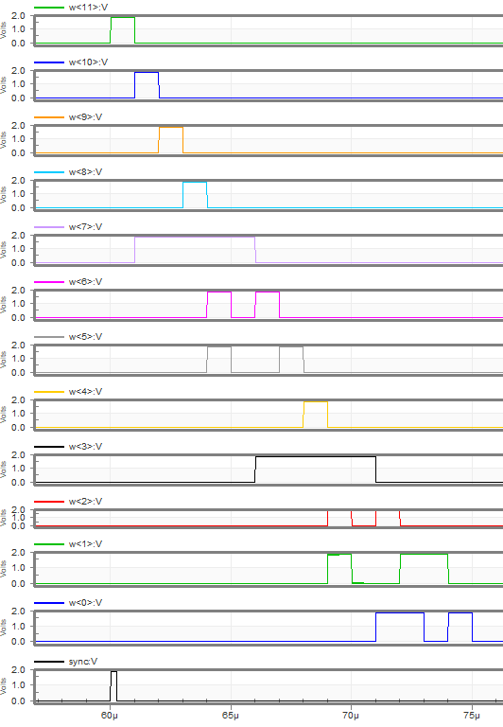
Circuit and simulation
This circuit makes the coefficients for the divide by 1.741 case. It can be built on top of the shiftregister of the sequencer.
See also Notebook 20221202ba “non-binary SARADC”
 | W<11:0>
factor | 100000000000 | 2048
1,741101 | 10010000000 | 1152
0,8 | 1010000000 | 640
 | 110000000 | 384
 | 11100000 | 224
 | 10000000 | 128
 | 1001000 | 72
 | 101000 | 40
 | 11000 | 24
 | 1110 | 14
 | 1000 | 8
 | 101 | 5
 | 11 | 3
 | 10 | 2
 | 1 | 1

Slide 87
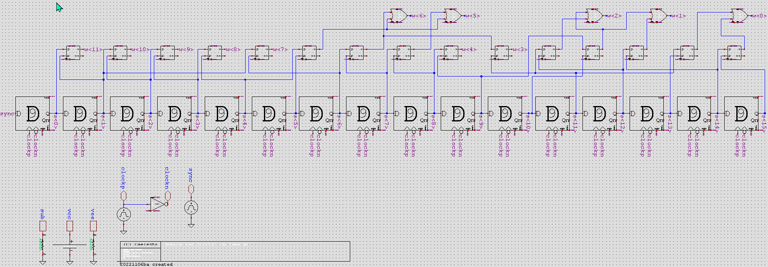
Circuit SB_saradc_factor1741
Scib library “SB” Cell “SB_saradc_factor1741”
Uses 15 SRFF and 5 OR2 gates, on top of sequencer shift register.

Slide 88
Radical non-binary
See Notebook 20221202ba “non-binary SARADC”
And second section of this course

Slide 89
Not interleaving?
Driving many parallel ADCs from one sequencer
One serializer feeding on many parallel or interleaved ADCs
A videobus can be interleaving or fully parallel.

Slide 90
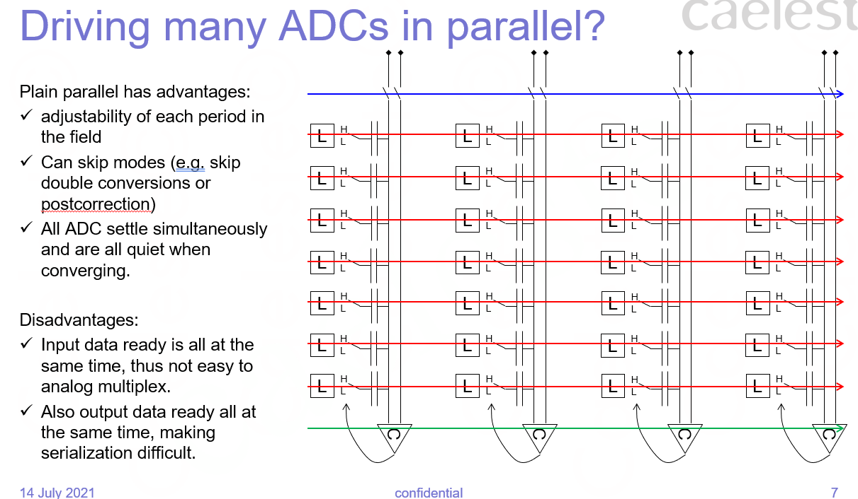
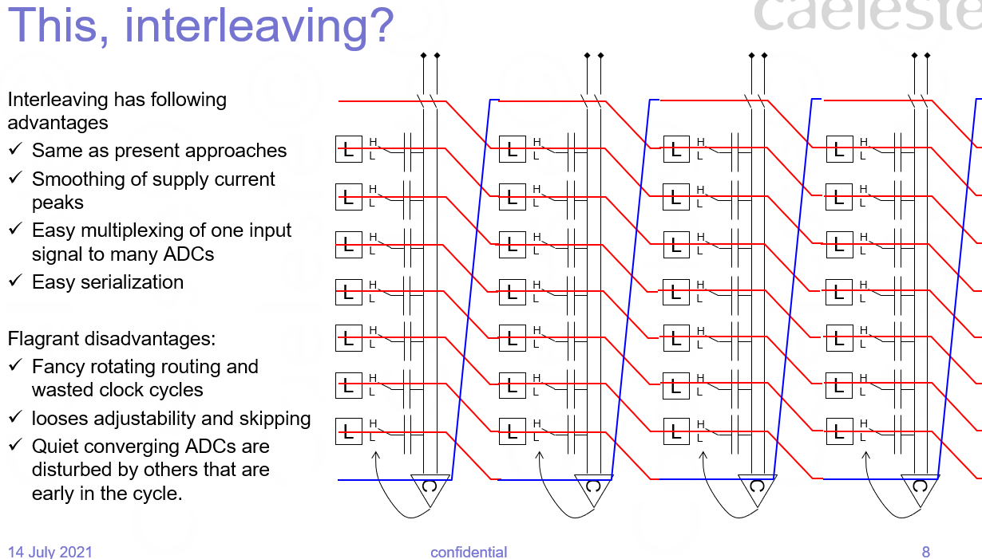
How to solve this?
←Notebook 0516
Separate the analog “A” and digital parts “D” of the ADC.
For a large array, one D drives many A, as DAAAAAAAA.
At larger scale, such groups may interleave.
For a small array, or single interleaving ADC, the ADC is a group of D-A pairs.
Interleaving or parallel
D
A
A
A
A
A
A
A
A
D
A
A
A
A
A
A
A
A
interleaving
D
A
D
A
D
A
D
A
Single ADC

Slide 91
3 subcircuits: modular approach
ADC core
inputs
Analog input sampling
Comparator clock
Adder/subtractor value
output:
Comparator bits
Sequencer
inputs
ADC clock/sync and ASPI bits
outputs
Adder/subtractor coefficients
Controls towards ADC core
Serializer
Inputs: AD converted values and LVDS clock/sync
Outputs: CML sender (or JESD204?)
ASPI
Sequencer
ASPI and analog inputs are considered external to the circuit.
VCC/VEE and VHIGH/VLOW are considered externally supplied.
ADC core
ADC core
ADC core
ADC core
CML io
Analog inputs
Mux/serializer
ADC core
ADC core
Define and design these three blocks separately with precise interfaces
ADC core
ADC core
Serializer should be a 12 (or 16) bit SER

Slide 92
Fully 1.8V

Slide 93
Fully operating @ 1.8V?
Can be done
Already today the digital logic is “LOG” logic, VCC=1.8V
Also the CDAC switches are LOG
Today 3.3V is only used in
The regulator
The comparator input preamp and the tail current sources of the other preamps.
The input buffer if any.
Potential issues:
What when migrating later to a LOG VCC=1.2V or lower?
What about the ADC might have an input voltage > 1.8V.

Slide 94
Alternatives to “SAR”

Slide 95
Adaptive step
Present SAR has equal weight/precision, irrespective the code you are at. One does not exploit a need for higher precision in the dark and a relaxed precision in the light, with higher PSN.
One idea:
Start near the dark (e.g. 0000010, with a limited step height.
Loop:
After comparison, step in the direction of the comparison
Find a next step height:
If the step direction reverses, decrease the step height with a factor [2x]
If the step direction is the same as before, increase it with factor [1.41x]
When step height < 1, end loop.
This or similar algorithm is convenient in the adder/subtractor topology
Not in next generation.
Potential idea but we have to let it mature. Probably not compatible with non-binary
The values 2 and √2 are a sweet spot as these are easy to approximate from the series … 1100 1000 110 100 11 10 1

Slide 96
Change of FLAMES compared to ATON
Change of FLAMES compared to ATON.
Input offset cancellation (also as Nova and similar to FPN cancellation of ELFIS2)
Starting point of group of 8
Disconnection the dummy CAPs, removed form the comparator inputs.
Comparator always without 3rd stage. Simulation show that it is always better to remove it.
Small difference in connection of regulator VSSA->VSSU
Always new DFF9
Carry out S=16 instead of S=4.

Slide 97
S&H

Slide 98
S&H
For low/minimal kTC noise
Knowing the result of Notebook 0653
Foresee a slow switching S&H, eventually an active feedback S&H

Slide 99
2. Non-binary SARADC
SARADC10

Slide 100
Goal of this course
Understand why we chose the non-binary SARADC concept
Why differential? Why pseudodifferential?
Why the modular approach with split between Sequencer and Core ADC
Why and how to combine the modules in interleaving and full parallel?
Understand the CDAC concept, how to construct this CDAC
Why non-binary
Why the series capacitors
How to calibrate the non-binary
On-chip versus off-chip nb2b
How to obtain the coefficients for nb2b
Understand the comparator, clocked or not clocked, its auto-zeroing, its output signals.
Understand the array aspects
Understand and contribute to future improvements
Improving speed / power
Increase resolution
Reduce large conversion errors, reduce noise, improve DNL/INL, improve PSR
Strive to a set of modular cells with limited parametrization

Slide 101
SARADC10: non-binary, short specsheet
Concept design: as “radical non-binary” in Notebook 0645 20221216ba non-binary SARADC.pdf
Topology: non-binary
Target number of bits: 12 to 14 when converted back to real binary
Input: Accepts fully differential and pseudodifferential
Internal number of (non-binary) bits: 16
Non-binary factor “radix”: ~1.8
Conversion non-binary to binary:
on-chip with a 16bit/16word adder
In-line (firmware) or off chip (software), i.e. acting on the non-binary word
Can easily run with less bits by simply having shorter SAR sequence and not serializing the extra bits.
Also difference form earlier topology:
Modular separation sequencer from core ADC: can easily make both parallel and interleaving
#ADCs in an interleaved group: baseline 8, yet also 16 (24, 32..) envisaged.
The true purpose of “non-binary” is to solve conversion errors and code gaps. It acts on every SAR conversion.

Slide 102
SARADC10: non-binary
Comparator
Topology strongly influenced by Millipede ADC design
Comparator keeps 3.3V capability, as we cannot guaranteed low input voltages.
1st stage remains the same. Experiment to add autozero in first stage as a programmable option not satisfactory and not maintained.
2nd stage is bypass-able.
2nd stage calibration switch 1.8V NMOS replaced with a 3.3V one. Avoids issues with high common-mode and speeds up the calibration. (is this justified)
Reset of the 1st and 2nd comparator stages is generated as in Millipede.
3rd stage removed as Monte Carlo simulations showed no offset cancellation benefits.
CDAC
Fully non-binary. No unary part, no RDAC part, no guardrings.
Subranging with capacitive division
“split capacitor” section to allow Vhigh-Vlow=1.8V, enables noise minimum shift
“offset capacitor” section to offset S versus R ranges when calibrating
Start-from-the-middle (monotonic) switching: no odd-even artifact. Possible drawback is common mode drift.
No design for matching as all mismatch compensation should be included in the non-binary

Slide 103
subcircuits: modular blocks
ADC core
inputs
Analog input sampling
Comparator clock
SAR bits
Sequencer
inputs
ADC clock/sync and ASPI bits
outputs
Controls towards ADC core
Serializer
Inputs: AD converted values and LVDS clock/sync
16 word NB2B convertor
Outputs: CML sender
ASPI
Sequencer
ASPI and analog inputs are considered external to the circuit.
VCC/VEE and VHIGH/VLOW are considered externally supplied.
ADC core
ADC core
ADC core
ADC core
serializer
Analog inputs
NB2B
(Mux)
CML io
ADC core
ADC core
ADC core
ADC core
Serializer handles 12 (adjustable 8…16) bit words.
This word length depends on lvds_clock / lvds_sync

Slide 104
Suitable for parallel and interleaving
The modular blocks are (should be) suitable for many different parallel and interleaving floorplans.
D
A
A
A
A
A
A
A
A
D
A
A
A
A
A
A
A
A
Huge parallel array of SARADCs
D
A
A
A
A
A
A
A
A
D
A
A
A
A
A
A
A
A
Interleaving of smaller parallel groups
Interleaving unit SARADCs
D
A
D
A
D
A
D
A
D
A
D
A
D
A
D
A
A: core ADC
D: sequencer

Slide 105
Towards a real standard cell (1)
The modules should be considered as rigid standard cells, with no or very limited parametrization
The sequencer
The sequencer is capable to drive both parallel and interleaved organizations, and also active sampling if needed. There is no variant schematic
The only parameter is S of the control outputs towards the ADC core. Advised S=1 (slow), S=4 (driving one core, interleaved) and S=16 (driving parallel)
The input stages
There are two variants in library SARADC
inputbuffer: just a buffer with bypass
inputbuffer_feedback: the same buffer, with capability to receive the feedback from SAMPLE_active (active sampling)
Parameters:
S=4, 16, 64 or 256 variants of the pdiff_keepwarm (SARADC10: W=40 thus S=133=~128)
Internally S/2
In principle the input stages must not be part of the ADC, except when using the “active sampling” feature

Slide 106
Towards a real standard cell (2)
The Sample & Hold part inside the CDAC as a whole
There are two variants of this cell, in library SARADC_CDAC
SAMPLE: the classic approach
SAMPLE_active: having active sampling and requiring access to the feedback inputs of the input stages
There should be a single parameter S (internally one should derive S_sample=S, S_conn=S/4, S_cal=S/8). Advised values are S=64 and S=16, congruent with parameters used in CDAC.

Slide 107
Towards a real standard cell (3)
The CDAC proper part is topology rigid.
It is conceived to have 16 conversions. As the LSB is small in size, we do not envisage to make N=14 or N+12 variants. Having less nominal bits is just a matter of having less ADC clocks
There are three parameters in the schematic cell
The Cmodel, type of capacitor
The strength of the switches. Parameter S applies to the MSB-switch of the nonbinary CDAC proper. All other switches (including those of Split and Level capactitors) refer to that. Proposed values are S=16 (SARADC10) and S=4
Value of capacitors, now implemented as W and L, thus Area. The parameter given are Wmsb and Lmsb of the MSB capacitor of the non binary CDAC prpoper.
These must be chosen so that C_{MSB}=1pF (nominal), 0.25 or 4pF. These determine the kTC noise of the ADC, hence:
C_{total}=7pF: nominal, assumed for 14 conversions thus about 12 equivalent binary bits
C_{total}=1.75pF: high speed/low power, for less than 12 equivalent binary bits
C_{total}=28pF: “low noise”, for 16 conversions thus about 14 equivalent binary bits

Slide 108
Towards a real standard cell (4)
The comparator
Should have a single parameter S. Advised values S=128 (present nominal) and S=32. Internally one derives S_preamp=S, S_offset=S/4, S_latch=S/16.
This S affects the 1/f and kTC noise of the comparator. Hence one should use S=128 for low noise and high resolution. S=32 (or even less) for higher noise / low power.
As the comparator is presently the dominant dissipator one must consider S=32 or even less in applications. Note that also the tuner setting affect this dissipation.
Notes:
In future designs, the comparator might evolve to a pure switching comparator.
Comparator dimensioning requires a thorough study , including the effects of calibration and auto-zero-ing on noise.

Slide 109
Non-binary CDAC

Slide 110
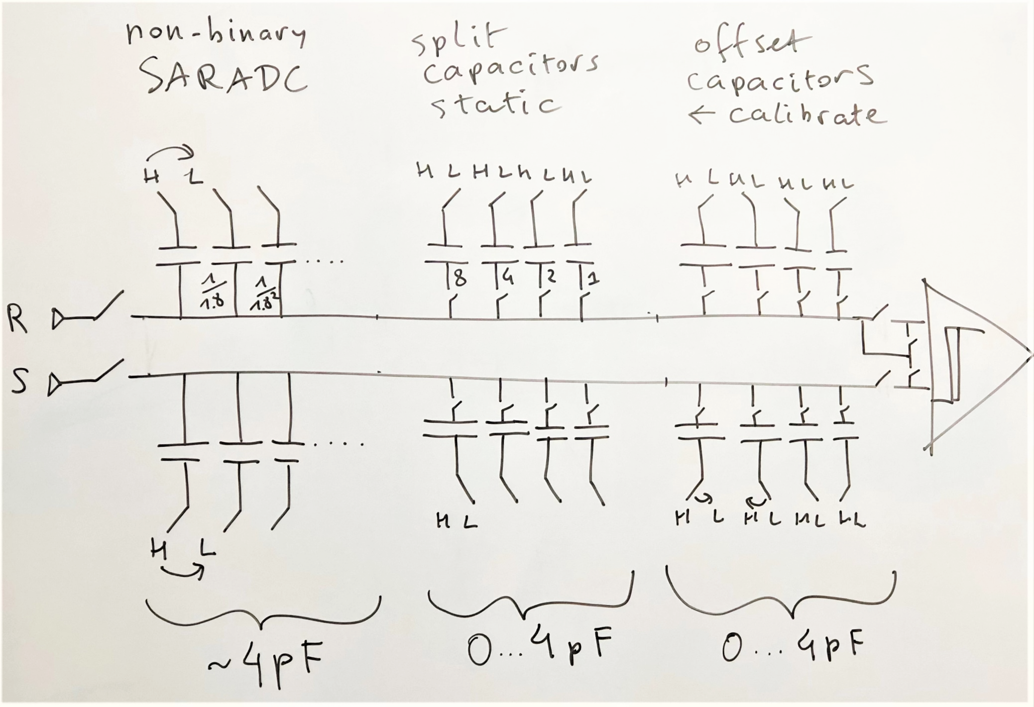
CDAC, overview
The CDAC capacitors are in three groups of about equal total capacitance.
The SARADC proper, operating in a “SAR” fashion, monotonic and non-binary.
The statically biased split capacitors, serving gain reduction and the possibility to do noise minimum shift.
The dynamically biased level shift capacitors, serving to level shift R versus S inputs.

Slide 111
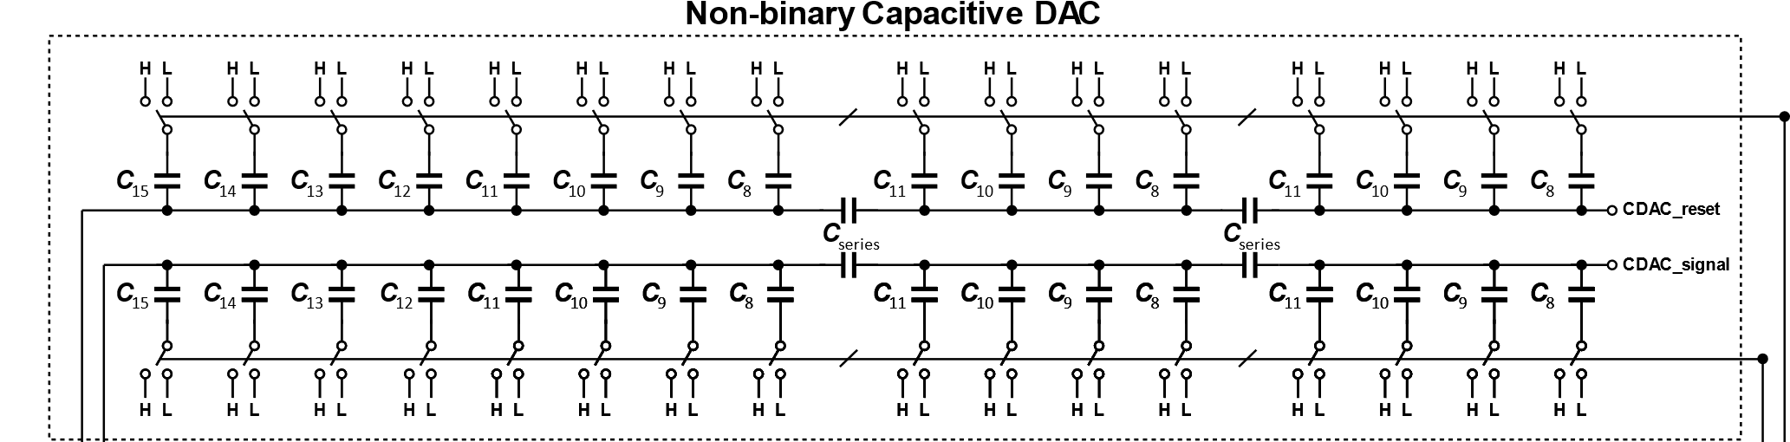
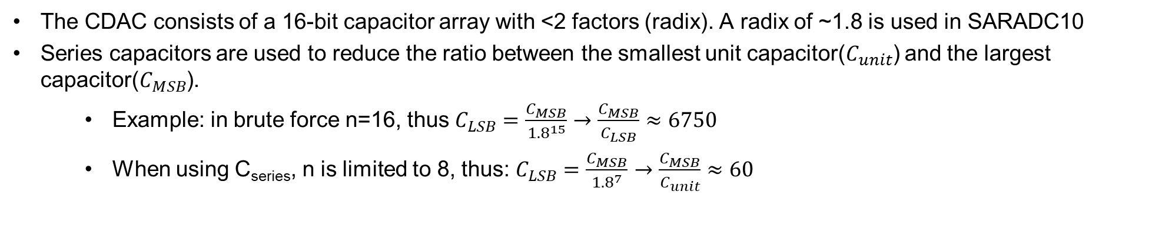
Non-binary capacitor array
The CDAC consists of a 16-bit capacitor array with <2 factors (radix). A radix of ~1.8 is used in SARADC10
Series capacitors are used to reduce the ratio between the smallest unit capacitor($C_{unit}$) and the largest capacitor($C_{MSB}$).
Example: in brute force n=16, thus $C_{LSB}=\frac{C_{MSB}}{{1.8}^{15}}→$ $\frac{C_{MSB}}{C_{LSB}}≈6750$
When using C_{series}, n is limited to 8, thus: $C_{LSB}=\frac{C_{MSB}}{{1.8}^{7}}$ $→$ $\frac{C_{MSB}}{C_{unit}}≈60$

Slide 112
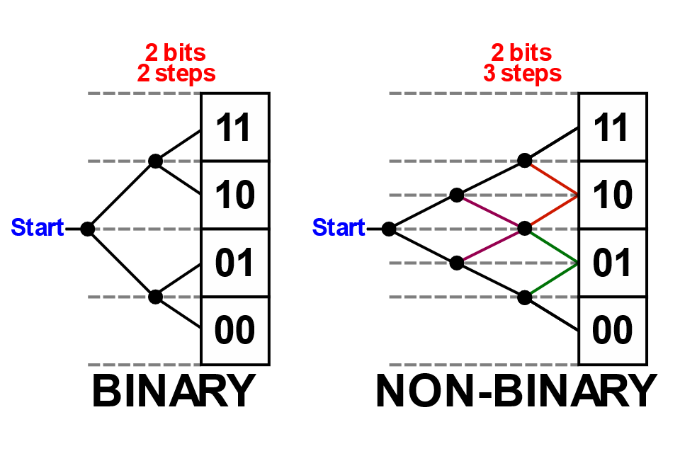
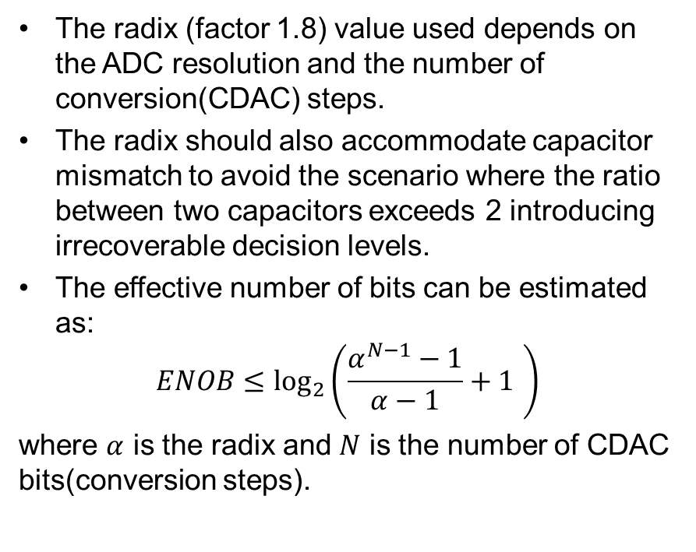
Non-binary capacitor array (Cont’d)
A binary-weighted SARADC is vulnerable to both static and dynamic errors. Its conversion efficiency, where each subsequent step is exactly halved, means that any decision error cannot be recovered.
A redundant, non-binary, architecture solves this problem by introducing overlap between the conversion range
The radix (factor 1.8) value used depends on the ADC resolution and the number of conversion(CDAC) steps.
The radix should also accommodate capacitor mismatch to avoid the scenario where the ratio between two capacitors exceeds 2 introducing irrecoverable decision levels.
The effective number of bits can be estimated as:
$$ENOB≤\log_{2}\left(\frac{α^{N−1}−1}{α−1}+1 \right)$$
where $α$ is the radix and $N$ is the number of CDAC bits(conversion steps).
Not so relevant drawing

Slide 113
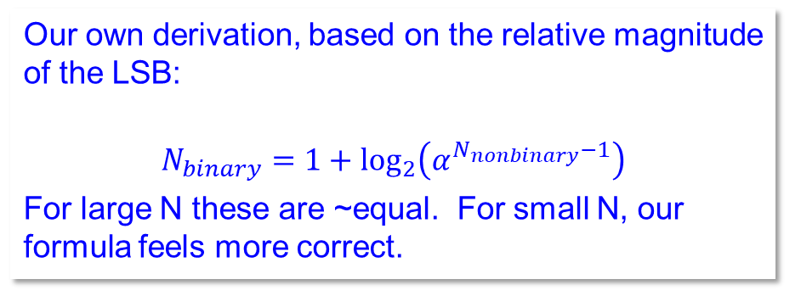
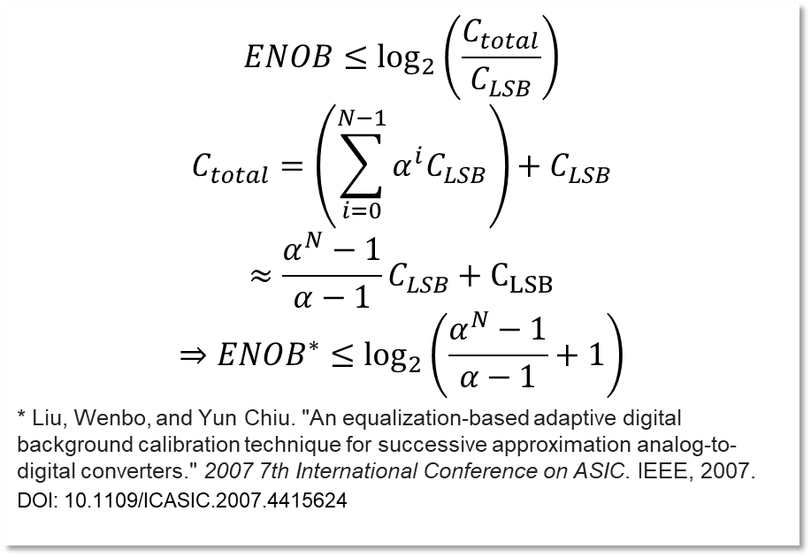
Equivalence of number of bits
the range of a non-binary ADC is larger than 2^{N}. For radix 1.8 it is up to 25% wider, or 0.3 bits
$$ENOB≤\log_{2}\left(\frac{C_{total}}{C_{LSB}}\right)$$
$$C_{total}=\left(\sum_{i=0}^{N−1}{α^{i}C_{LSB}}\right)+C_{LSB}$$
$$≈\frac{α^{N}−1}{α−1}C_{LSB}+C_{LSB}$$
$$⇒ENOB^{∗}≤\log_{2}\left(\frac{α^{N}−1}{α−1}+1\right)$$
* Liu, Wenbo, and Yun Chiu. "An equalization-based adaptive digital background calibration technique for successive approximation analog-to-digital converters." 2007 7th International Conference on ASIC. IEEE, 2007.
DOI: 10.1109/ICASIC.2007.4415624
alfa | 1,8
N_{nonbinary} | Liu Equiv. N_{binary} | Our Equiv. N_{binary} | Account for wider range equiv. N_{binary}
1 | 1,70 | 1,00 | 1,15
2 | 2,34 | 1,85 | 2,05
3 | 3,05 | 2,70 | 2,94
4 | 3,82 | 3,54 | 3,81
5 | 4,62 | 4,39 | 4,68
6 | 5,44 | 5,24 | 5,54
7 | 6,28 | 6,09 | 6,40
8 | 7,12 | 6,94 | 7,25
9 | 7,96 | 7,78 | 8,10
10 | 8,81 | 8,63 | 8,95
11 | 9,65 | 9,48 | 9,80
12 | 10,50 | 10,33 | 10,65
13 | 11,35 | 11,18 | 11,50
14 | 12,19 | 12,02 | 12,34
15 | 13,04 | 12,87 | 13,19
16 | 13,89 | 13,72 | 14,04
Our own derivation, based on the relative magnitude of the LSB:
$$N_{binary}=1+\log_{2}\left(α^{N_{nonbinary}−1}\right)$$
For large N these are ~equal. For small N, our formula feels more correct.

Slide 114
Non-binary capacitor array (Cont’d)
Another advantage to redundancy is that the size of the CDAC capacitor array can be dimensioned noise-limited rather than matching-limited, leading to a reduction in size.
No requirement for exact matching, thus the design style based on a unit capacitor can be abandoned.
No requirements for guardings. Any mismatch due to a missing guardring is solved as well by the non-binary to binary conversion.
A smaller capacitor array leads to:
Lower area
Lower power consumption
Faster settling
Redundancy relaxes settling constraints as well since errors due to incomplete settling are recoverable.

Slide 115
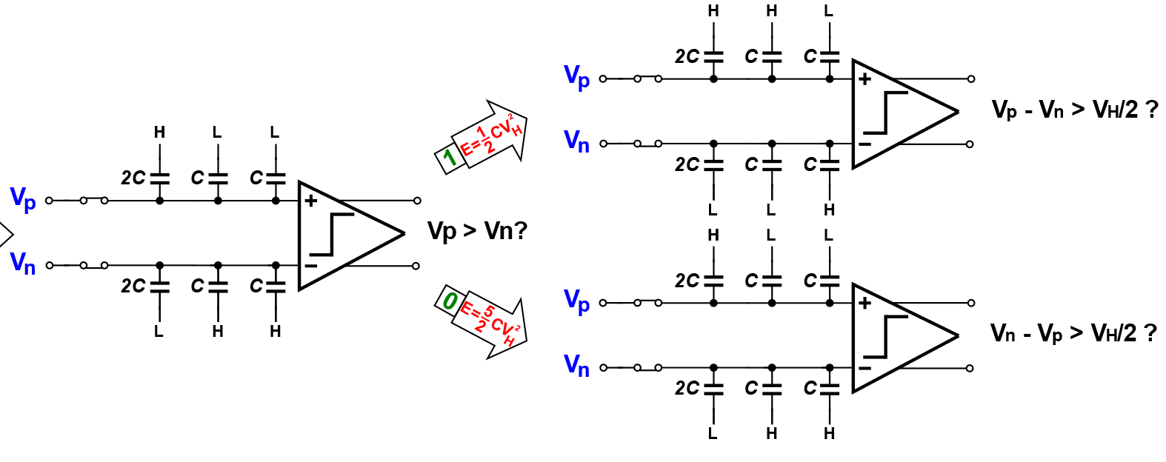
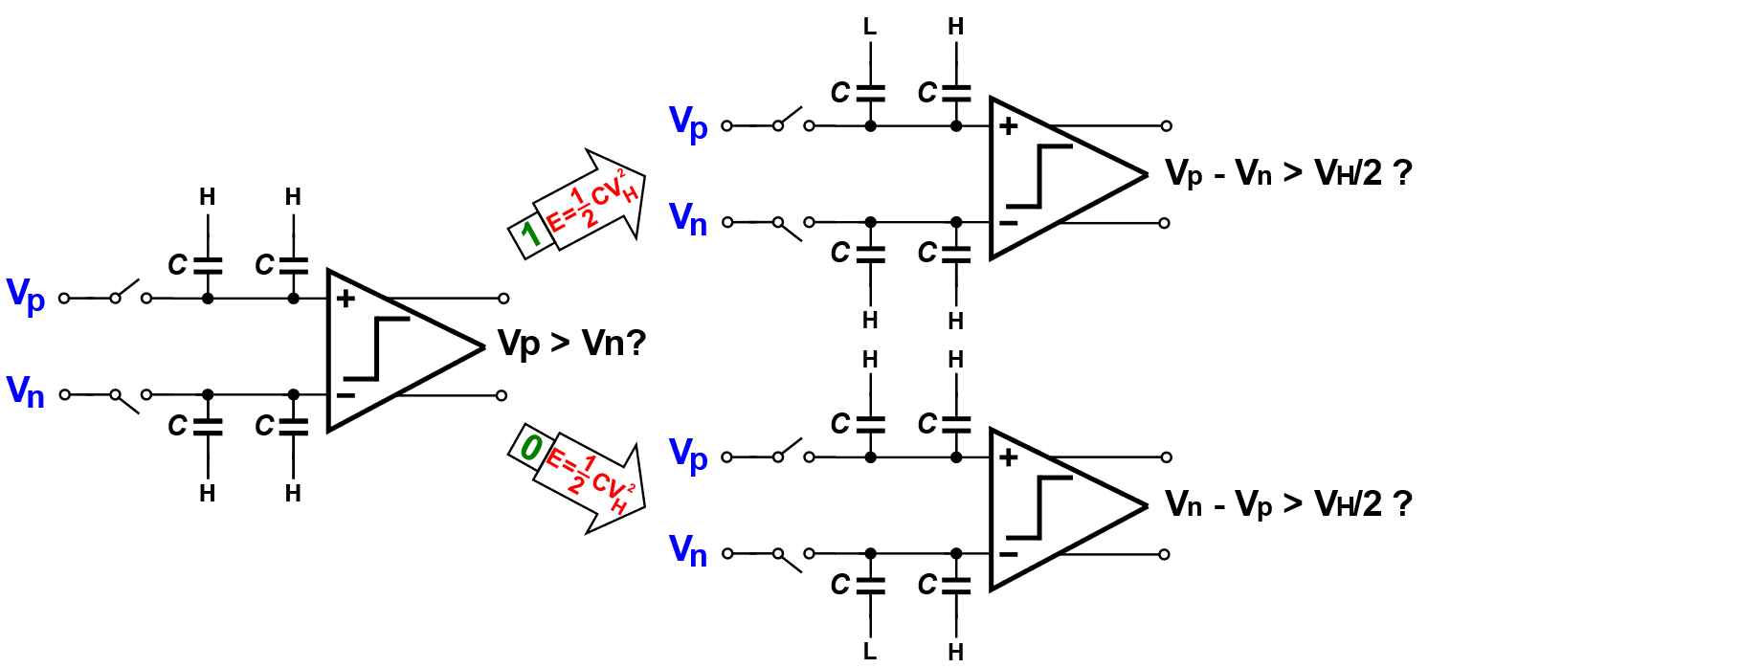
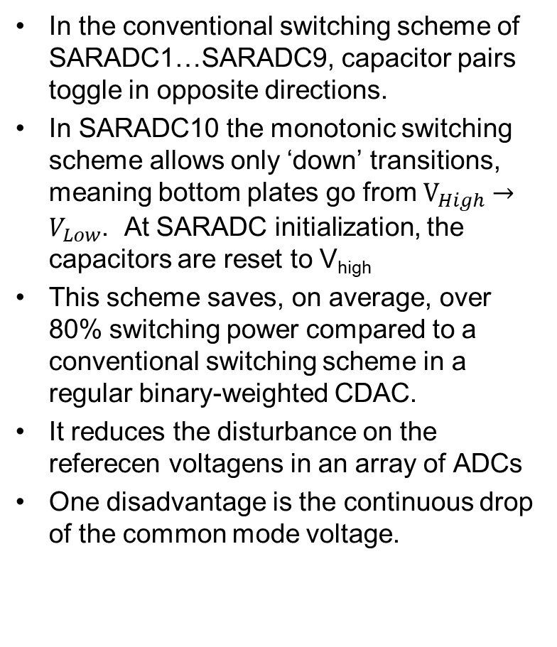
Monotonic switching scheme
In the conventional switching scheme of SARADC1…SARADC9, capacitor pairs toggle in opposite directions.
In SARADC10 the monotonic switching scheme allows only ‘down’ transitions, meaning bottom plates go from $V_{High}→V_{Low}$. At SARADC initialization, the capacitors are reset to V_{high}
This scheme saves, on average, over 80% switching power compared to a conventional switching scheme in a regular binary-weighted CDAC.
It reduces the disturbance on the referecen voltagens in an array of ADCs
One disadvantage is the continuous drop of the common mode voltage.
Conventional
Monotonic

Slide 116
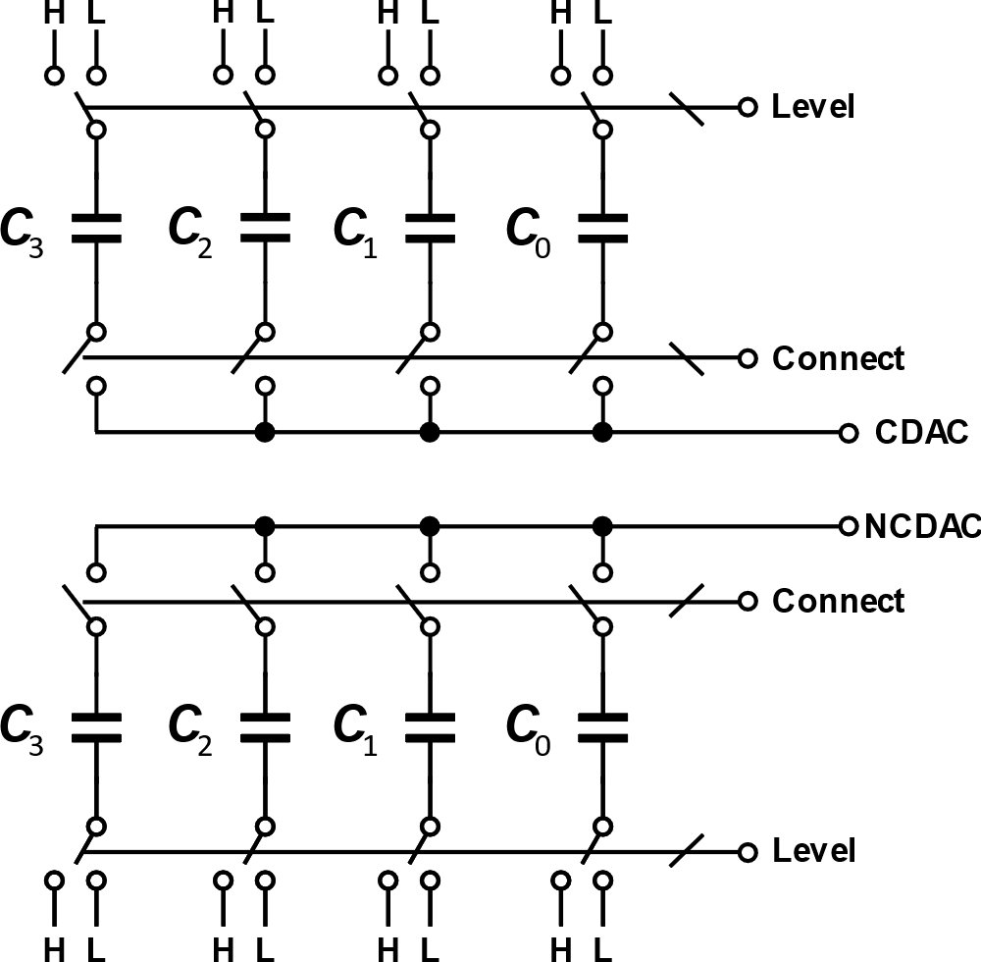
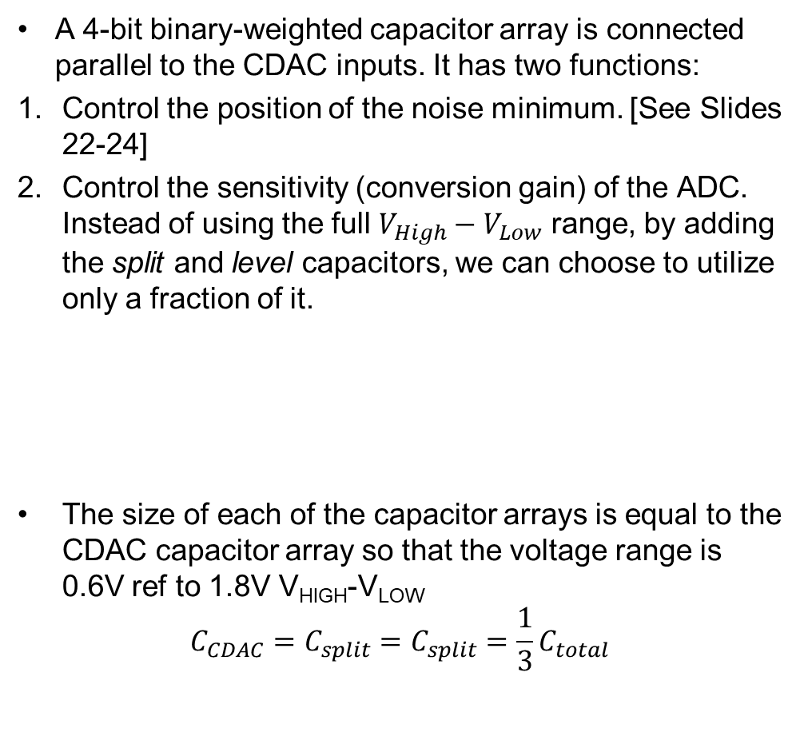
Split capacitors
A 4-bit binary-weighted capacitor array is connected parallel to the CDAC inputs. It has two functions:
Control the position of the noise minimum. [See Slides 22-24]
Control the sensitivity (conversion gain) of the ADC. Instead of using the full $V_{High}−V_{Low}$ range, by adding the split and level capacitors, we can choose to utilize only a fraction of it.
The size of each of the capacitor arrays is equal to the CDAC capacitor array so that the voltage range is 0.6V ref to 1.8V V_{HIGH}-V_{LOW}
$$C_{CDAC}=C_{split}=C_{split}=\frac{1}{3}C_{total}$$

Slide 117
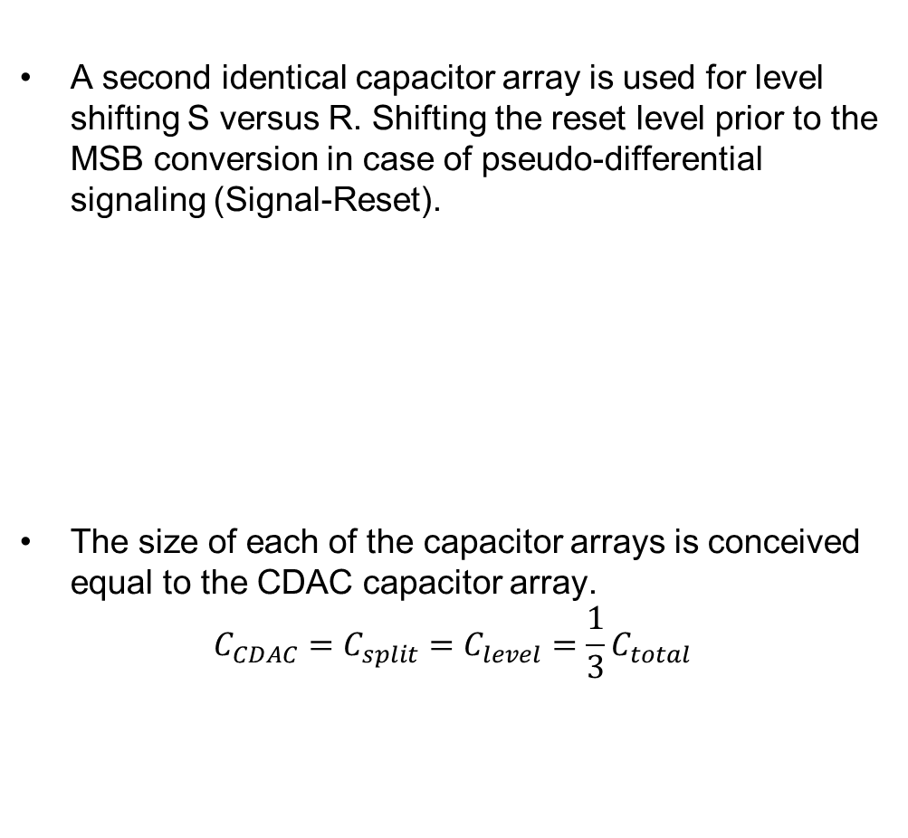
Level shift capacitors
A second identical capacitor array is used for level shifting S versus R. Shifting the reset level prior to the MSB conversion in case of pseudo-differential signaling (Signal-Reset).
The size of each of the capacitor arrays is conceived equal to the CDAC capacitor array.
$$C_{CDAC}=C_{split}=C_{level}=\frac{1}{3}C_{total}$$

Slide 118
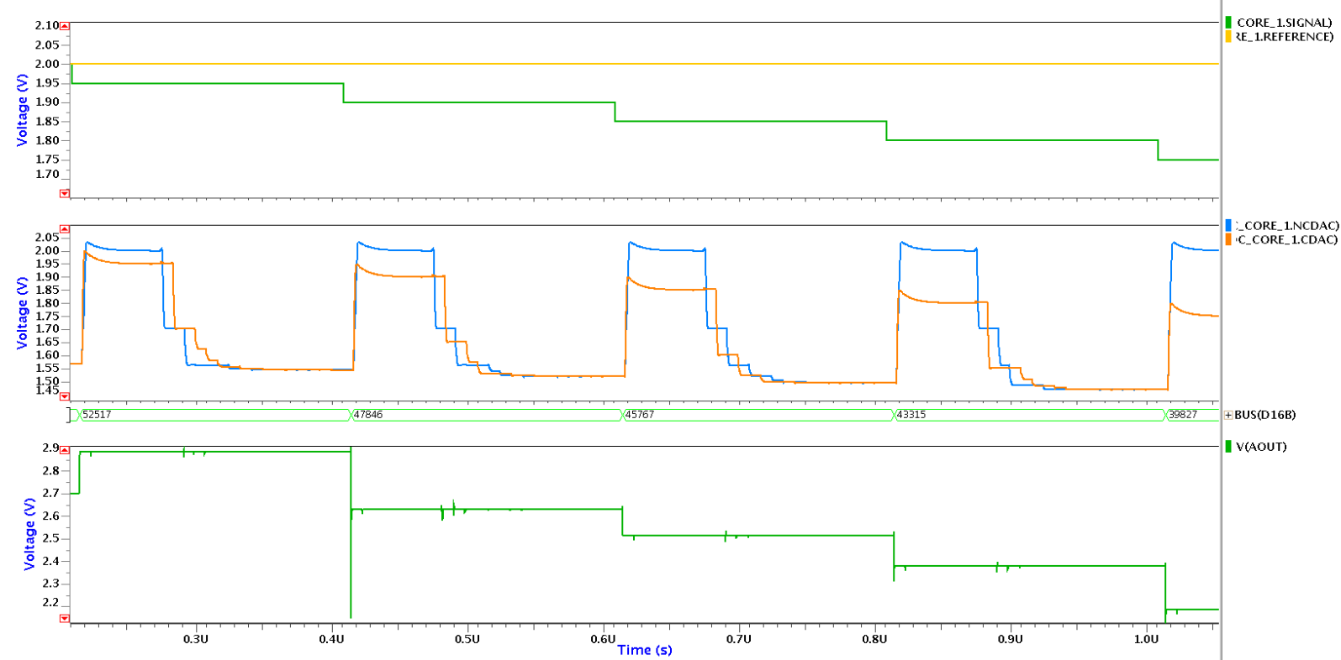
Simulation Example@120MHz
Input
levels
MSB
Reset Level Shift
ADC
Output
SPICE
16b DAC

Slide 119
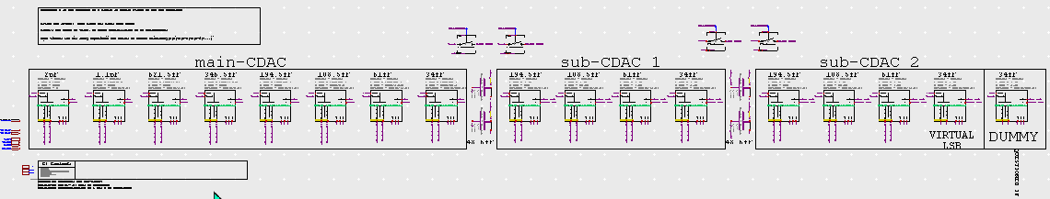
Parametrization on the non-binary CDAC
The only parameters given to the non-binary CDAC are:
Cmodel: flavor of capacitor
S: strength of the switch of the MSB.
Lower switches are each time divided by 2 (indeed, this is imperfect, but OK)
Lmsb and Wmsb: size of the MSB capacitor
Lower capacitors are obtained by dividing L or W by radix 1.8, see table
Coupling capacitor scale factor is empirically found. It is 1.42x larger than the previous capacitor (pls recheck)
The Capacitors behind the coupling C are copied from the 4 last capacitors before the coupling.

Slide 120
Parametrization of the split/level capacitors
The parameters given to the split & level shift capacitors are:
Cmodel: flavor of capacitor
S: strength of the switch of the MSB.
Lower switches are each time divided by 2
Lmsb and Wmsb: size of the MSB capacitor
The Split and Level C_{mbs} is 1.2x larger than the SAR (non-binary) C_{mbs}. In this way one makes that each of the SAR, Split and Level capacitor groups have the same total input node capacitance
Lower capacitors are obtained by dividing L by 2, 4, 8

Slide 121
Comparator

Slide 122
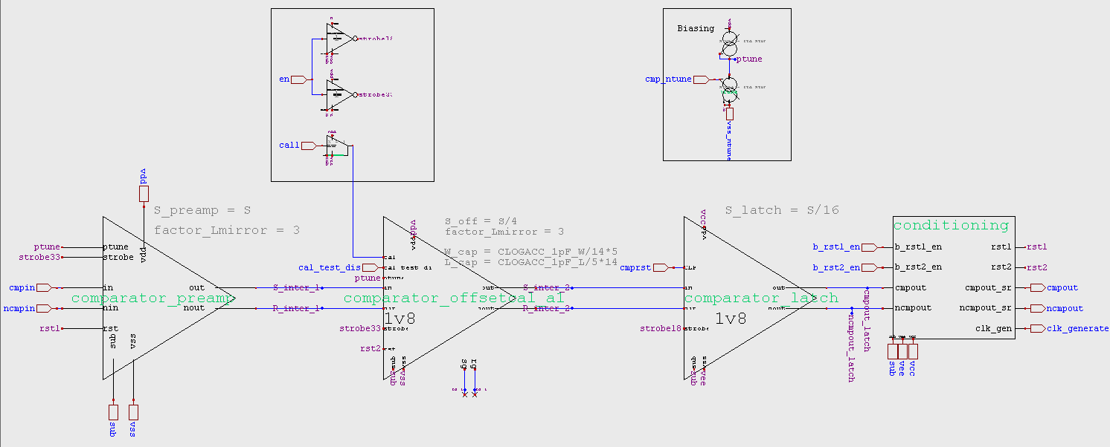
Comparator
The comparator is largely identical to the one of the binary SARADC. It consists of 3 stages:
Preamplifier
Gain stage with and offset cancellation
Latch
Two modes of operation:
Nominal Mode (Three-stage mode): First stage: preamplifer + Second stage: offset cancellation
No offset cancellation Mode: Second stage bypassed.

Slide 123
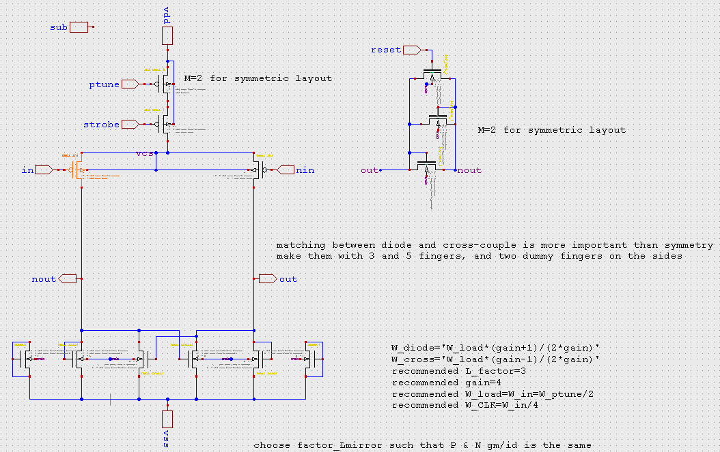

Comparator Stage 1 Preamplifier
The preamplifier serves two purposes:
Act as a low-noise gain stage.
Accommodate a wide input common-mode range.
Design Considerations:
Maintaining a similar bias (operating) point for the PMOS input and NMOS load, the sizes as a function of the gain can be approximated as: $W_{cross}=W_{diode}−\frac{W_{in}}{A}$
where $W_{cross}:$ width of the cross-coupled NMOS
$W_{diode}:$ width of the diode-connected NMOS
$W_{in}:$ width of the input PMOS
A gain of 4 is usually used.
Dummy fingers (in earlier designs) removed as an accurate gain value is not a specification.

Slide 124

Comparator Stage 2: Offset Cancellation
The second stage serves two purposes:
Gain stage.
Reduce the offset of the preamplifier as well as its own.
It is possible to bypass the second stage. This is useful in case no calibration is used (you can do that by setting cal_time<1:0> to 0).

Slide 125

Comparator Stage 3: Latch
The latch provides a rail-to-rail 1.8V comparator output.
Design Considerations:
Input, strobe and PMOS switch scale with the size of the latch.
Cross-coupled pair sizes are kept minimum.
Reset NMOS switches have minimum size as the comparator reset speed is inconsequential.

Slide 126

Experiment: single stage “All-in-One” Preamplifier
The idea was to do the preamplification and offset cancellation all in one stage.
A programmable solution was proposed as shown in the figures to maintain the old functionality as well.
However, the addition of the calibration switch introduces a complex pole pair in the left-half plane.
That leads to a ripple on the output in the nominal mode which can be sustained through the cross-coupled pair(positive feedback).
Therefore, this solution was not pursued due to a risk of oscillation.

Slide 127




Experiment: single stage “All-in-One” Preamplifier (2)
The damping factor is affected by the switch size, the load $g_{m}$ and the capacitance values(parasitic, load, calibration).
The simulations and models suggest a minimum switch size of 8 to avoid peaking at this given operating point.
R | Switch S | Damping Factor (ζ)
$$20kΩ$$ | 1 | 0.28
$$10kΩ$$ | 2 | 0.39
$$5kΩ$$ | 4 | 0.55
$$2.5kΩ$$ | 8 | 0.77
0 | No switch | flat
Conclusion: do not do this, keep two (bypassable) stages

Slide 128
Sequencer

Slide 129


Sequencer concept: chain of DFFs
The sequencer consists of a dff9_sync0 chain that controls the timing of the ADC.
Prior to AD conversion, several operations need to take place:
Calibration 2. Sampling 3. Level shift (S versus R)
DFFs with programmable #clocks delay are used to accommodate different conversion rates.
The nominal mode uses 24 clock cycles: 6(Calibration)+1(Sampling extension)+1(level)+16(SAR onversion).
0.1.3.7

Slide 130

Sequencer:
Outputs:
UPLOAD: latches the output bits after conversion.
SAR<0:15>: propagates 16 comparator decisions to the CDAC.
SAMPLE[Hard]: samples the R&S inputs on the CDAC.
CALIBRATE: the inputs of the comparator are shorted to the R signal and the comparator offset is recorded if offset cancellation is enabled.
CONNECT: the CDAC is connected to the comparator after calibration.
NEXT: SYNC towards next ADC in an interleaved configuration.
COMPARATOR CLOCK: resets comparator latch.
Inputs:
CLOCK: sequencer clock
SYNC: kickstarts the sequencer defining the ADC cycle.

Slide 131
Sample&hold
Classic sample&hold
Active sample&hold

Slide 132

Classic: cell SAMPLE
Baseline in the design is this “classic” S&H.
The cells has but one parameter S, then
S_sample = S
S_conn = S/4
S_cal = S/8

Slide 133

optional: cell SAMPLE_active
Uses active sample & hold, with cell
[lib stdcells] active_sh
The concept of active S&H is explained in Notebook 0653 20230120amba noise simulations on active sample and hold.pdf
Expected improvement in SARADC is speculative
No 100% conclusive theorem or simulation
In this implementation we put active S&H only on the series sampling switch. What about the other switches?

Slide 134
Design/Simulations/Details
Ahmed kept logs at:
"S:\projects\scib\IPblocks\SARADC\SARADC10\Caeleste documents\20221228am SARADC10.pptx“
"S:\projects\scib\IPblocks\SARADC\SARADC10\Caeleste documents\20221230am Everything ADC.xlsm"

Slide 135
Serialization
For an interleaved configuration
For a parallel configuration

Slide 136

Serializing interleaved core ADCs
The ADC core has a 16 bit output “D<0:15>”.
Its is brought out via a nmux_unitcell when “upload” is high.
These can be directly shunted in parallel to a bus as input to the serializer.
As this bus likely has a significant capacitance, one uses it as dynamic memory.

Slide 137
Serializing parallel core ADCs
The solution of previous slide cannot be used as is for a parallel configuration.
One need an extra set of nmux_unitcells,
accessed by a shiftregister where
Sync is ADC_sync
Clock is LVDS_sync

Slide 138

Serializer
Fixed topology and schematic to handle 16 bits,
identical approach as in the binary SARADC.
One can output less bits by apply less LVDS_clock/LVDS_sync

Slide 139
NB2B
Non-binary to binary conversion

Slide 140
approaches
The runtime conversion
Software, off-line
the non-binary word, bit per bit is multiplied by its weight
Hardware, on-chip
The same algorithm
the hardware realization is an array of 15 16-bit adders, conditionally adding 16 “weights”.
Firmware, in FPGA
similar as the Hardware implementation
when mature, may serve as a baseline to retarget to on-chip hardware implementation
The calibration
=One time per design/waferlot/wafer/device pinpointing the 16 weights

Slide 141
DATASHEET
SARADC10

Slide 142
Contents
Electrical Specifications
Power Consumption
Timing Specifications
Timing Setup Examples
ASPI Registers

Slide 143

Electrical Specifications
Symbol | Parameter | Conditions | Minimum | Typical | Maximum | Unit
$$V_{CC}{−V}_{EE}$$ | Supply Voltage |  | 1.7 | 1.8 | 1.9 | V
 | Supply Noise |  |  | 1000 |  | $$μV_{rms}$$
 | Supply Voltage |  | - | 0 | - | V
V_{HIGH}-V_{LOW} | Voltage |  | 1.7 | 1.8 | 1.9 | V
 | Noise | Signal proportional |  | 50 |  | $$μV_{rms}$$
 | Noise | uncorrelated |  | 100 | 100 | $$μV_{rms}$$
 | Noise | Correlated to clocks |  | 1000 |  | $$μV_{rms}$$
$$I_{V_{CC}}\&I_{V_{EE}}$$ | Supply current | Average
 |  | Peak
 |  | FWHM
$$V_{DD}$$ | Supply Voltage |  |  | 3.3 |  | V
 | Supply Noise |  |  | 1000 |  | $$μV_{rms}$$
$$V_{SS}$$ | Supply Voltage |  | - | 0 | - | V
$$I_{V_{DD}}\&I_{V_{SS}}$$ | Supply current | Average
 |  | Peak
 |  | FWHM
sub | Supply Voltage | reference | - | 0 | - | V

Slide 144

Power Consumption similation@120MHz
Block | Sub-block | Minimum | Typical | Maximum | Unit
Sequencer | Total |  | 0.1 |  | mW
Core | Total |  | 3.28 |  | mW
 | Input Buffer |  | 0.7 |  | mW
 | Sample and Hold |  | 0.02 |  | mW
 | CDAC |  | 0.06 |  | mW
 | Control Logic |  | 0.57 |  | mW
 | Comparator |  | 1.92 |  | mW
Input buffer tuner=17(linear range: $9→17$).
Comparator tuner=19(linear range: $13→22$).
Average over full conversion period?
A single core and a single sequencer?

Slide 145
Timing Specifications
Symbol | Parameter | Conditions | Minimum | Typical | Maximum | Unit

Slide 146
Example Timing Setups
The “next” signal is the “sync” of the subsequent ADC core in an interleaved architecture.
The case of only 1 clock cycle delay for the “next” ADC core is not implemented as it is only relevant for fitting 16 interleaved ADCs into 16 clock cycles. In such case one better fits 8 pairs of ADCs.
Sampling starts with calibration. The shortest possible sample time is one clock cycle on top of the calibration time.
we assume that the #bits readout must be a divider of the ADC conversion duration.
No. of Interleaved ADCs | Next Delay #clks (code) | ADC conversion duration #clocks | Calibration #clks (cal_time code) | Sample and Hold (Extra) #clks (sample_time code) | Active Sample and Hold #clks (ssoft_time code) | Level shift #clks (level_time code) | #of SAR steps | #Bits read out over serializer
8 | 2 (00) | 16 | 1 (01) | 1 (00) | 0 (00) | 1 (00) | 13
8 | 2 (00) | 16 | 0 (00) | 1 (00) | 0 (00) | 1 (00) | 14
8 | 3 (01) | 24 | 7 (11) | 1 (00) | 0 (00) | 1 (00) | 15 | 12
8 | 4 (10) | 32 | 7 (11) | 4 (10) | 0 (00) | 4 (00) | 16 (+1 void) | 16
12 | 3 (01) | 36 | 7 (11) | 8 (10) | 0 (00) | 4 (00) | 16 (+1) | 12
8 | 5 (11) | 40 | 7 (11) | 4 (10) | 7 (11) | 1 (00) | 16 (+3) | 16
4 | 2 (00) | 8 | 0 (00) | 1 (00) | 0 (00) | 1 (00) | 7 | 8

Slide 147
1.8V ASPI Registers
ASPI register: Sequencer timing
Bit | Name | Default Value | Function
9:8 | next_delay<1:0> | 0 | Control the delay of the “next” sync signal. 00: 2 clock cycles 01: 3 clock cycles 10: 4 clock cycles 11: 5 clock cycles
7:6 | level_time<1:0> | 0 | Control the duration of the level shift operation. 00: 0 cycles 01: 1 cycles 10: 3 cycles 11: 7 cycles
5:4 | ssoft_time<1:0> | 0 | Control the no. of active sampling clock cycles. 00: 0 cycles 01: 1 cycles 10: 3 cycles 11: 7 cycles
3:2 | sample_time<1:0> | 0 | Control the no. of extra sampling clock cycles. 00: 1 cycles 01: 2 cycles 10: 4 cycles 11: 8 cycles
1:0 | cal_time<1:0> | 3 | Control the no. of calibration clock cycles. 00: 0 clock cycles (no calibration) 01: 1 clock cycles 10: 3 clock cycles 11: 7 clock cycles
20230417baab name change

Slide 148
1.8V ASPI Registers (Cont’d)
ASPI register: Serializer and bit patterns
Bit | Name | Default Value | Function
 |  |  | Controls bits 8-10 in the ADC teach code. Removed, these are hardcoded
17 | teach | 0 | Apply the hardwired teach code to the output latch of the ADC.
16:1 | bitpattern<15:0> | 0…0 | Controls the test bit pattern for the serializer.
0 | select_bitpattern | 0 | Apply the test bit pattern to the input of the serializer.

Slide 149
1.8V ASPI Registers (Cont’d)
ASPI register: Split capacitors
Bit | Name | Default Value | Function
11:8 | split_ncdac<3:0> | 0000 | Select the voltage on the bottom plate of the split capacitors connected to the negative CDAC node. 1111: VHIGH, VHIGH, VHIGH, VHIGH 1000: VHIGH_{MSB}, VLOW, VLOW, VLOW … 0000: VLOW, VLOW, VLOW, VLOW
7:4 | split_cdac<3:0> | 0000 | Select the voltage on the bottom plate of the split capacitors connected to the positive CDAC node. 1: VHIGH 0: VLOW
3:0 | split_conn<3:0> | 1111 | Connect the top plates of the split capacitor array to the CDAC nodes.

Slide 150
1.8V ASPI Registers (Cont’d)
ASPI register: level shift capacitors
Bit | Name | Default Value | Function
9 | level_node | 0 | Select the CDAC node to apply the offset to: 0: NCDAC 1: CDAC
8 | level_direction | 0 | Select the offset polarity. 0: negative offset 1: positive offset
7:4 | level_bit<3:0> | 1000 | Control the value of the offset from VLOW to VHIGH with a 4-bit resolution.
3:0 | level_conn<3:0> | 1110 | Connect the top plates of the offset capacitor array to the CDAC nodes.
Note 20230417baab change name from “offset” to “level”

Slide 151
3.3V ASPI Registers
ASPI register: Input buffer and comparator
Bit | Name | Default Value | Function
4 | b33_byp_comp2 | 0 | Bypass the comparator stage 2. (1=yes, 0=no)
3 | b33_en_rst2 | 1 | Enable the reset signal of the comparator stage 2.
2 | b33_en_rst1 | 1 | Enable the reset signal of the comparator stage 1.
1 | b33_strobe_comp | 0 | 1=Strobe the ADC comparator: All comparator stages are powered off
0 | b33_byp_inbuff | 0 | Bypass the input buffer of the ADC.

Slide 152
simulations
SB_core_plus_sequencer

Slide 153


SB_core_plus_sequencer

Slide 154

Transient

Slide 155

Zoom in
Reference: 1.8V
Signal: 1.8->1.2V
Radix 1.8 DAC (analog1.8) looks ~nice linear
“normal binary radix 2” (analog20) shows uneven steps.

Slide 156

Sweep with 1/100 range

Slide 157

SB_nonbinary_CDAC
Simulation bench showing each successive delta V.
Allows to quickly check the radix factors, targeted to be ~1.8
1,800257 |  | factor
 | 1,6279
 | 1,7033 | 1,777664
 | 1,7455 | 1,770678
 | 1,7696 | 1,786117
 | 1,783 | 1,776496
 | 1,79046 | 1,761458
 | 1,79485 | 1,81191
 | 1,79723 | 1,786257
 | 1,798555 | 1,778496
 | 1,79929 | 1,760083

Slide 158
Non-binary: future improvements

Slide 159

Improve cell CDAC_control_unit_nonbinary in library SAR_CDAC
Ample opportunity to reduce the number of gate delays.
Must watch out
Avoiding glitches
E.g. decision must propagate to CDAC after the latch releases its reset, so as to avoid reversal of decision
Include comparator reset timing (latch reset, (pre)amp reset)
Include SAR timing
Try to realize “correct by construction”, so as not to be dependent on unpredictable layout parasitics.
Compare to earlier much simpler cell next slide

Slide 160

Earlier version: _obsolete20230202_CDAC_control_unit
This is an earlier generation of +/- the same.
It worked (?)
Has much less gate delays
but has glitches (?).
Can one devise a compact elegant control unit not having the glitches?

Slide 161


Simplify BBM switches
The CDAC uses BBM switches2. They are fully complementary and symmetric on both inputs.
However, when switching between VHIGH=1.8V and VLOW=0V, a single PMOSFET and NMOSFET suffice.
One could eventually replace all bottom switch2bbm_fast by switch2bbm_highlow_fast

Slide 162
Split/level capacitor switches
The switches on this position are presently 1.8V fast switches.
However, the R and S may be higher than 1.8V.
Solutions?
Make these 3.3V switches (baseline). Whatch out to maintain short RC timeconstant.
Put these switches at the bottom. Possible by logically combining them in the bottom LH switches. (not baseline)
…

Slide 163

CDAC coupling cap: do this for every bit.
Advantages: somewhat simpler design
Identical unit cell for 8 LSB
Same radix for all 8 LSB
Avoids non-linearity of the subranges.
Experiment fails: this C2C arrangement cannot result in a radix 1.8. Only radix > 2.
Alternative: per group of 2?

Slide 164
Non-binary CDAC approximating radix with #unit caps
As in Notebook 0677
What if the non-binary CDAC is composed of matched unit capacitors?
This facilitates or freezes the adder coefficients.
Examples of how the eight MSBs might be assembled:
The only remaining variable is the size of the coupling capacitor, which must remain finely programmable on its own (as in TIMA paper).
Greatly simplifies parameter upload to 16xADDER. Adder itself becomes smaller. Yet makes the CDAC(proper) much bigger

Slide 165

NB2B with integer weights
From Notebook 0645
94
52
29
16
9
5
3
2
The weights can be encoded in a 8-bit word, adding to a maximum value of 210. One needs 7 [8-bit or less] adders.
The weights of the lower bits add up to less than the above “2”, again can be realized in 8 (7/8/9) bit adders. These coefficient are variable, yet have a large systematicity.
For comparison Notebook 0645 brute force approach→

Slide 166
Memory effect
It was suggested that settling of the inputs stage causes memory effect 20230713 layout review of SARADC10
A way to cancel his might be to briefly shunt / preset / precharge the capacitor nodes.
Needs confirmation.

Slide 167
Embed upload<> generation in each ADC core.
Presently (SARAD10) the circuit xscanner_parallel8 created the control to enable the output of data of each ADC core in sequence.
We propose to remove xscanner_parallel8 and embed short pieces of DFF9 inside each ADC core. This ressembles the earlier implementation of “sync/next” circuitry in the sequencer to be used in interleaving mode.
Advantage:
Scalable, not needing to know number of parallel cores in advance
Simpler circuit, no cleansync,
Using DFF9 instead of DFF5 which still has risk of racing.

Slide 168


Sequencing upload<> in parallel configuration
The core ADCs are driven in parallel from the sequencer.
There is a separate little shiftregister enabling the upload from each core in sequence. The “upload<>” controls are made by a separate circuit xscan_parallel8.
We propose to remove this and replace it by a solution as in next slide.

Slide 169



sync/next shiftregister when interleaving
For use in the interleaving topology, each sequencer contains a short shiftregister, propagating its own “sync” with a delay to “next” sync of the next ADC sequencer&core. This realizes the delayed start of conversion for the interleaved ADC cores.
phi_a is generated by sync, aligning it to clock
Programmable delay
Extra Latch at the end to create next sync

Slide 170
“Cheap” true binary operation mode
The non-binary ADC has 16 nominal bits, stemming from 15 consecutive capacitor pairs being toggled. Capacitor values decrease with factors ~1.8.
The difference with a simple classic SARADC is minimal. The essential difference are the factors being as exactly as possible equal to 2. However such configuration suffers from dynamic errors leading to missing codes around major bit transitions.
What if we compose the Capacitors partly of unit capacitors, so that they can be used in two modes
Non-binary, where capacitance ratios are ~1.8, all as previous
Binary where capacitance ratios are equal to 2 by unit capacitor number.
In this mode we take the burden that dynamic errors will happen. Probably not more that 8 useful bits
Yet, the raw ADC output is the final ADC output. No NB2B conversion needed
20231116ba

Slide 171

“Cheap” true binary operation mode
Implementation example as if only 4 bits.
The black 1:1/2:1/4:1/8:… series should be as exactl as possible.
The red extra capacitors could be only approximately.
In binary mode only the black part switches
In non-binary mode both black and red parts switches.

Slide 172
3. Helena & SASC

Slide 173

From company presentation

Slide 174
Array of ADCs: helicopter view
The trade-off space is obvious:
Maximize FOM_{CSA} Conversions/second/area
Minimize FOM_{EPC} energy per conversion for a given bit resolution
Pick the right resolution and perhaps make even this selectable/programmable. E.g. 1/4/8/12bits

Slide 175
Array of ADCs: designers viewpoint
Suitable to put in an array
Aligned to [multiple of] column pitch
If ADC in the column: no analog domain memory effect and artifacts
Not sensitive to crosstalk by/to supply lines and DC references
Elegant power distribution
Differential versus SE (Pseudo-diff) signaling

Slide 176

Approach:
Slide from Notebook 0045(!)→
Compact version of our classic SARADC, with double conversion and postcorrection.
Further:
To optimize FOM_{CSA}, no unary and just a few double conversions.
Fully differential
“clock only high-low” (monotonic clocking)
Non-binary remains option

Slide 177

Approach:
Identical logic as the previous
Fully differential and monotonic
Both binary and non-binary possible
Non-binary:
Most compact capacitors as matching is not really needed.
Slow settling to 10% is permitted as conversion error is corrected non-binary.
downside: need non-binary to binary re-coding outside the chip
Binary: using unit capacitors
Easy to make 4/8/12 bit operation: just give less clocks.
.
1 1/1.8 (1/1.8)² (1/1.8)³ …

Slide 178
FOMs: EPC and CSA
Figures of merit
EPC (energy per conversion) must go down to 0.01 nJ range
CSA (conversions per second per area) area must be something like 1000… µm²
routes are
Less bits
Smaller capacitors and other circuits.
Careful choice of circuit topology
No (or minimal) DC dissipators
Low supply voltages
Proposed solution in Notebook 0746

Slide 179

Exercise: Notebook 0746
In this Notebook we show that
it possible to reach EPC=10pJ
it is possible to layout the core ADC is 1000µm²
Conversion rate for 8…10bit is at least 10MHz.

Slide 180
ADC: selectable resolution
It may be an attractive idea to exchange speed versus resolution in operation, then one can
e.g. nominal speed @4bit. Single bit resolution is probably useless or wo speed advantage
half speed @8bit (local)
third speed @12bit (local)
quarter speed @16bit (local) (only for non-binary or double conversion etc)
Implementation with a SARADC is +/- elegant as one clocks more/less
Output multiplexing of the ADC result to the next faster hierarchy is via a 4bit bus. One can access the bus 1, 2, 3… times
In case of double conversion ADC, one does the 4bit speed without double conversions (DC) and addition
The 8bit speed may be without DC, but with addition.
The 12bit case may have triple readout of 4bit bus, reducing it to effective 10 bit.
The 16bit case may have quad readout of the 4bit bus, reducing it to effective 12bit. Or 14? Or keep all. Anyway the downstream speed is more relaxed.

Slide 181
Use the SARADC itself as gainstage
The cheapest: gain x2
Omit the offset switching to bring the reset level halfway the signal range. Tie the offset caps to vss which is better for PSR and noise.
Put the MSB without comparison to 0 and do not read its value out. Consider the MBS-1 as MSB (and barrel-shift the bits one position)
This is essentially gain 2x.
In a similar but more sophisticated way on can do the same with more bits, thus realizing 4x, 8x gain. Hardware shift the bits 1, 2, 3 positions.
e.g. this mode would be useful for low light imaging where number of grey levels is low.
Take care that the suppressed (tied to zero) higher bits act do not cause overflow when the signal exceeds the range.
When implementing this, do not enter performance limiting trade-offs

Slide 182


The “SASC” library SARADC sub-circuits
First implementation of modular SARADC (20240601ba)
In-SARADC
sample*
cdac*
comparator*
Common
sequencer*
rdivider*
* means: pincompatible variants, topologies
Legacy “flat” design
“SASC” design

Slide 183
Comparator as in SASC
For fast applications:
- Single stage preferred
- no tuner is needed if implemented as a pure clocked comparator
- No offset calibration is preferred, however, the option must exist
- this removes the time needed for the settling of first stage
Con:
- limited gain of one stage is not enough for high ENOB applications
… I need more thought and study on this … is kick back ‘really’ an issue?
kTC noise of clocked latch/comparator is well understood

Slide 184
kTC and power consumption
Case studied:
1V swing
12b ADC
250uV LSB
Target: 0.25*LSB for each contributor (1pF equivalent)
CDAC: 1pF (total) on R input, 1pF on S input
Assuming a monotonic switching scheme,
(plus buttom plate parasitics)
1pF should be switched (1V)
comparator: For noise reasons, 1pF/16 as its output load (each side?) (assuming an implicit gain of 4)
Comparator will toggle around 16 times during one conversion
2pF should be switched (1.8V or 3.3V).
Input buffer: can be designed with probably same energy as CDAC

Slide 185

Modular SASC library (Notebook 0769)

Slide 186

Modular SASC library (Notebook 0769)

Slide 187

Modular SASC library (Notebook 0769)

Slide 188

Modular SASC library (Notebook 0769)
Re-analog is a pure mathematical operator. This is not a circuit.

Slide 189
Features of SASC
In a binary SARADC with UB, DC and PC, one needs to add spurious bits input a single output word
Contains 5 modules and variants
In-core: sample, cdac, comparator
Common: sequencer, rdivider (optional)
Not included (yet): multiplexing multiple ADCs, serializer, binary addition, NB2B
Variant modules are schematic symbol compatible
Variant modules have a sequence number appended: comparator1, comparator2…
Non-binary to binary conversion

Slide 190
SASC CDAC features
SASC CDACs must comply to
Monotonic switching (only high→low)
Uses the cdac1_unitcell latch
cdac1_unitcells: has parameter “S” strength, for use with larger capacitors
cdac1_unitcellr: accepts the interpolated voltages of the rdivider, for the lower bits.
Nature of the capacitors in not in the schematic cell.
Binary variants are built from unit capacitors
Non-binary variants have plain capacitors
Binary variants can have unary bits (UB), double conversion (DC) and even postcorrection (PC).
Needing afterwads a simple addition to combine all spurious bits
Less significant bits are based on a common resistive division on the “high reference”, created by a rdivider cell

Slide 191
SASC comparator features

Slide 192
SASC “sample” (input stage) features

